Slide 1
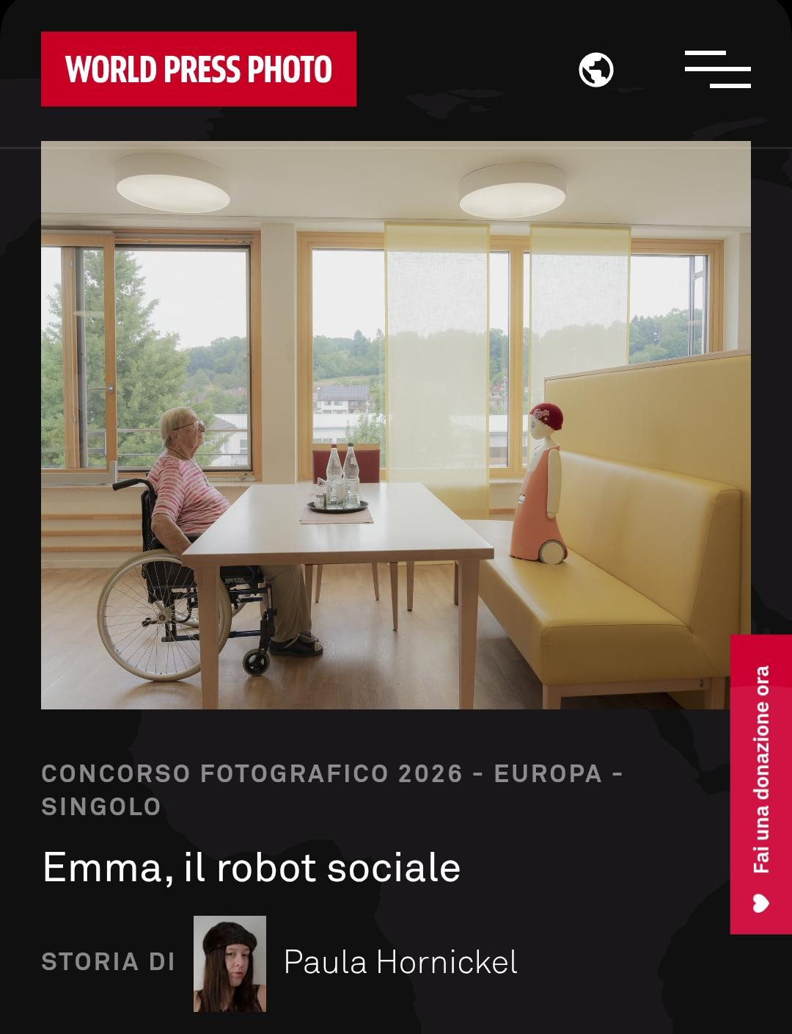
D.U.S.E. (University Department for Sustainability and Evolution)
University Smart City and Humanoid Assistants on Wheels
A systemic convergence of Human-Centric Robotics, Bio-Architecture,
and Human Capital
Patrizia
Boi
Engineer, Writer, Journalist

Slide 2
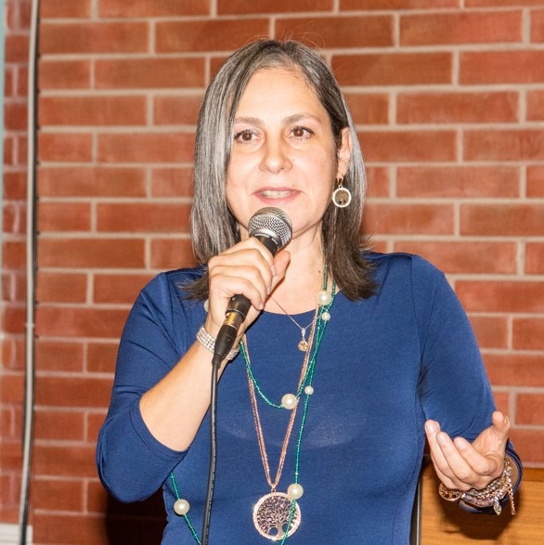
INTRODUCTION
D.U.S.E. is the concrete result of my vision: a deep SYNTHESIS between SCIENCE, ETHICS, and SOCIAL NEEDS.
D.U.S.E. transforms INNOVATION into a tool for regenerating BIOLOGICAL WELL-BEING and supports the DEMOGRAPHIC TRANSITION of our peoples by solving the problem of.
TIME SHORTAGE
.
MY EXPERTISE
MY IDEA
I am a SENIOR ENGINEER with over thirty years of experience at FS (ITALIAN STATE RAILWAYS).
I am also a JOURNALIST and author of the book ‘INGEGNERIA ELEVATO N’.
In my book, I argue that DIGITALIZATION must serve as a MULTIPLIER OF HUMANITY.
Photo

Slide 3
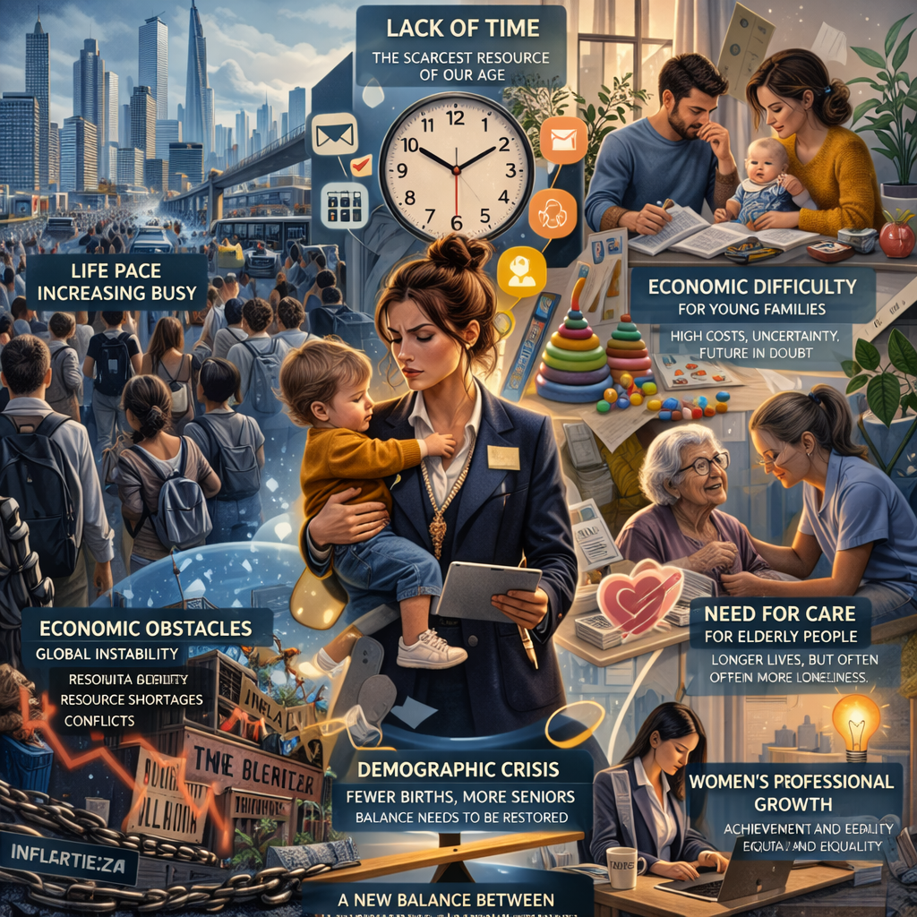
WHY?
Current SMART CITIES are
LIFELESS SPACES
modeled on digital grids that
ISOLATE the individual.
The unsustainable COST OF LIVING
fuels an unprecedented
BIRTHRATE COLLAPSE:
delegating 3D TASKS
(Dirty, Dull, Dangerous)
is the only way to restore
dignity to MOTHERHOOD
and human time.
B

Slide 4
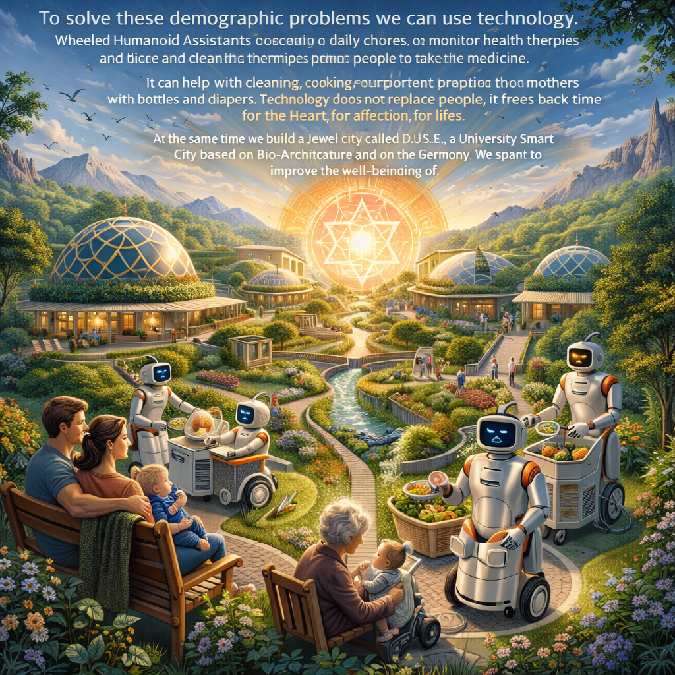
WHAT?
THE CONCRETE SOLUTION: ROBOTICS AND HARMONY
D.U.S.E. is a LIVING LAB,
a LIVING ORGANISM
where the
WHEELED HUMANOID ASSISTANT
takes on the most burdensome tasks.
A BIO-ARCHITECTURAL space
that nourishes the soul through
SOLAR HARMONY and SACRED GEOMETRY.

Slide 5
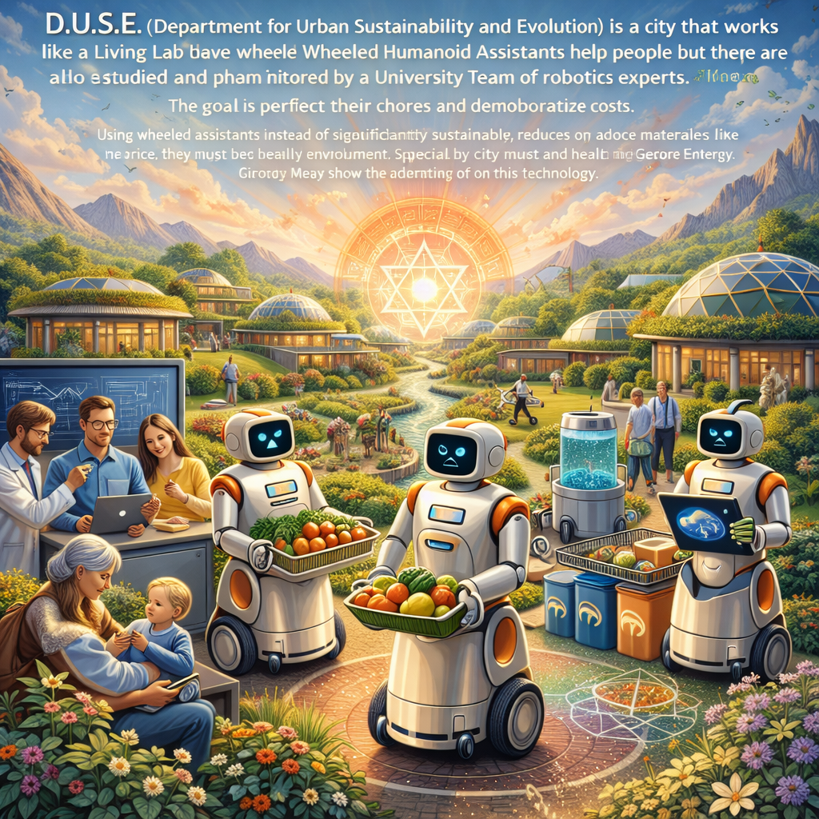
HOW?
ENGINEERING RIGOR AND
TECHNOLOGICAL SOVEREIGNTY
Robots on WHEELS to ensure stability, efficiency, and the DEMOCRATIZATION of costs.
We use NATURAL MATERIALS
in collaboration with
the Russian excellence of the
SKIF center in NOVOSIBIRSK.
Managing every process through the power of
5D BIM and VIRTUAL COMMISSIONING.

Slide 6
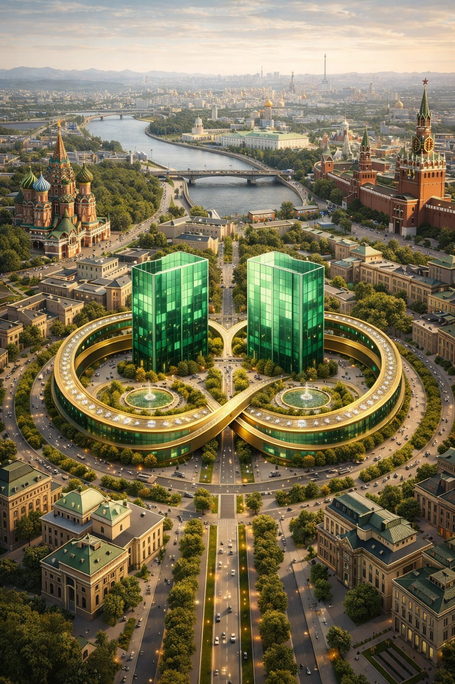
GLOBAL IMPACT
A WELL-BEING CELL FOR A MULTIPOLAR WORLD
Through EDGE COMPUTING,
we guarantee
DATA SOVEREIGNTY:
AI works within the home, protecting family PRIVACY.
D.U.S.E.
transforms the Smart City into a
LIVING CITY
that generates
HAPPINESS and ACTIVE LONGEVITY.

Slide 7
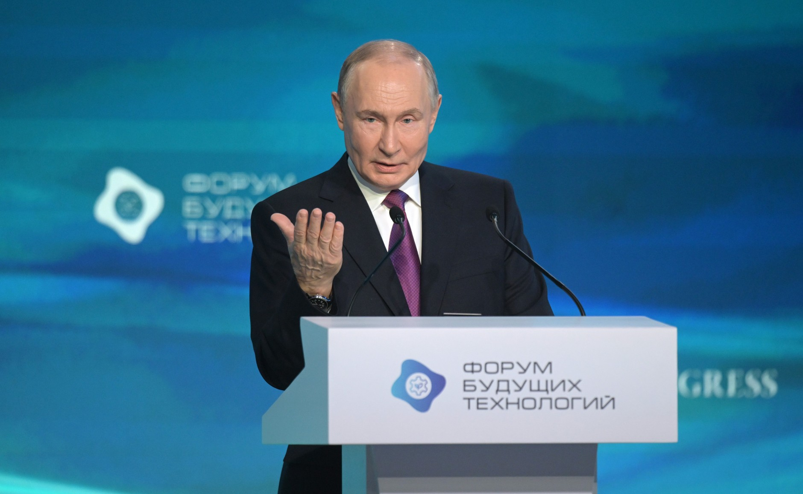
ADDRESSING MEGATRENDS AND BIOECONOMY
D.U.S.E. delivers results:
providing time for DEMOGRAPHY,
ensuring SOVEREIGNTY through Russian robotics, and integrating the BRICS
into a RESILIENT urban model.
It is the practical realization of the
BIOECONOMY
envisioned by PRESIDENT PUTIN.
Just as ELEONORA DUSE stripped
the superfluous from theater,
we strip away toxic concrete
for the THEATER OF LIFE.
«Drawing on the principles and wisdom of nature... to support quality of life and active longevity.»
VLADIMIR PUTIN
Спасибо

Slide 8
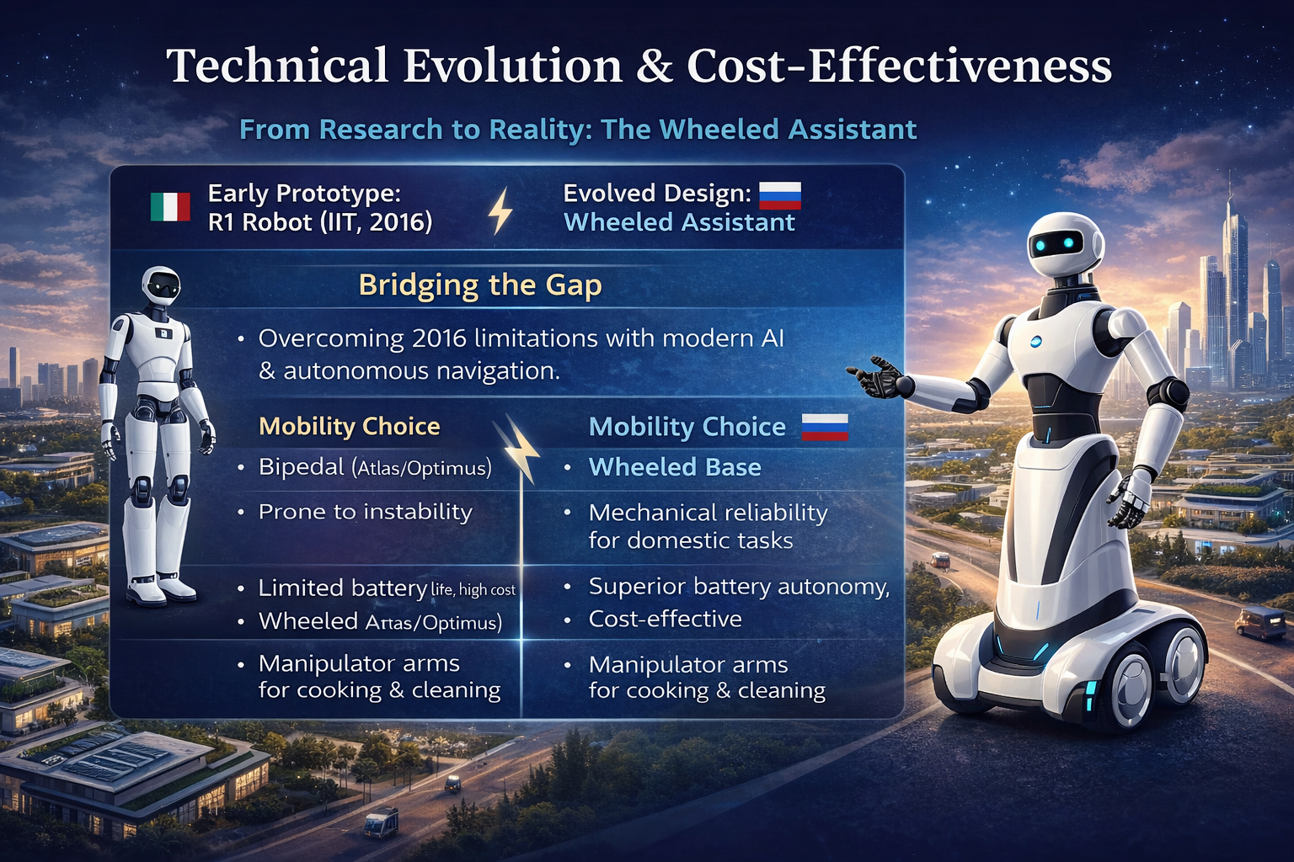
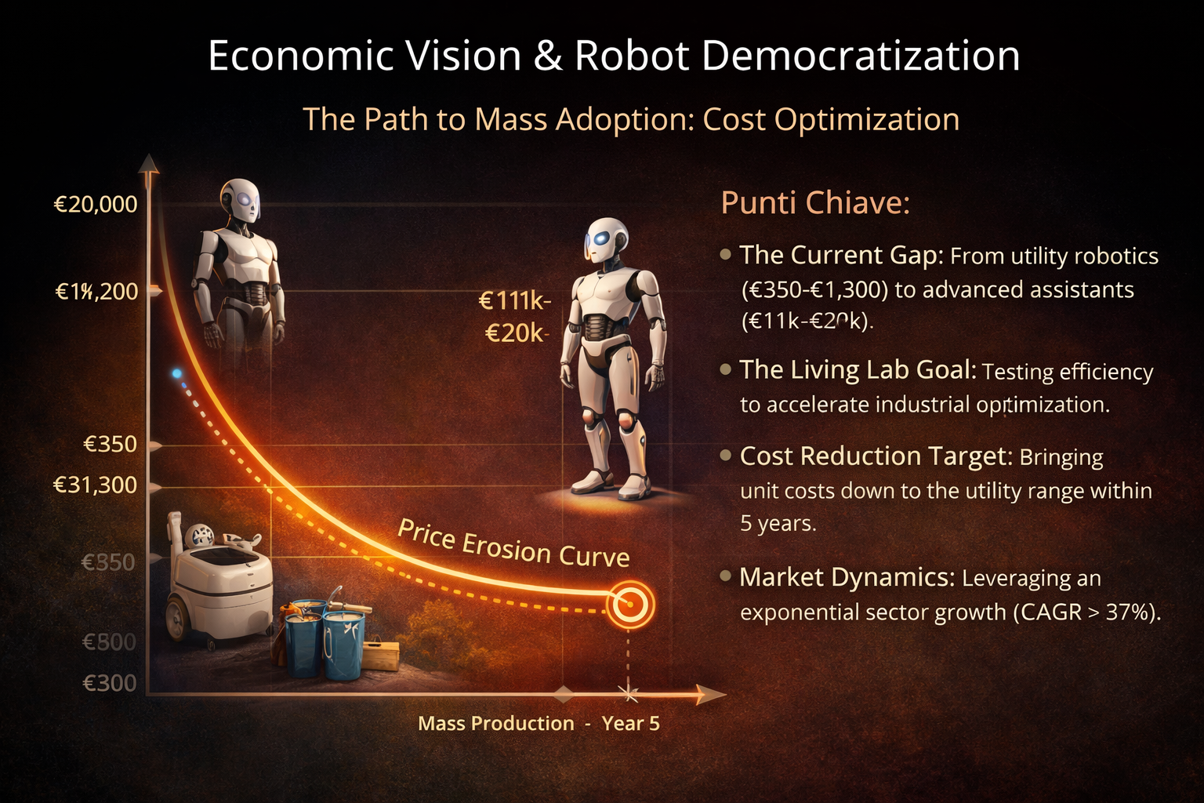
THE DEMOCRATIC HUMANOID
THE WHEEL AS A CHOICE OF CIVILIZATION AND DEMOCRACY
D.U.S.E. rejects expensive, bipedal “LUXURY" robots in favor of a pragmatic, universal solution. By removing ARCHITECTURAL BARRIERS, we make legs unnecessary.
DEMOCRATIC EFFICIENCY: Wheeled robotics are stable, safe, and cost-effective. This is ROBOTICS FOR FAMILIES, not just for the elite. It ensures reliability: a wheeled assistant doesn't fall and consumes less energy.
UNIVERSAL DESIGN: In a "ZERO-BARRIER" environment, the wheeled robot, the elderly with a walker, and the child in a stroller share the same space in HARMONY.
EURASIAN SYNERGY: We combine CHINESE HARDWARE (manufacturing power) with RUSSIAN SOFTWARE (algorithmic logic) to focus all energy on CARE not on the complexity of movement.
If we eliminate the step from architecture, we eliminate the unnecessary cost from technology. The wheel is the engine of a NEW COLLECTIVE SERENITY.

Slide 9
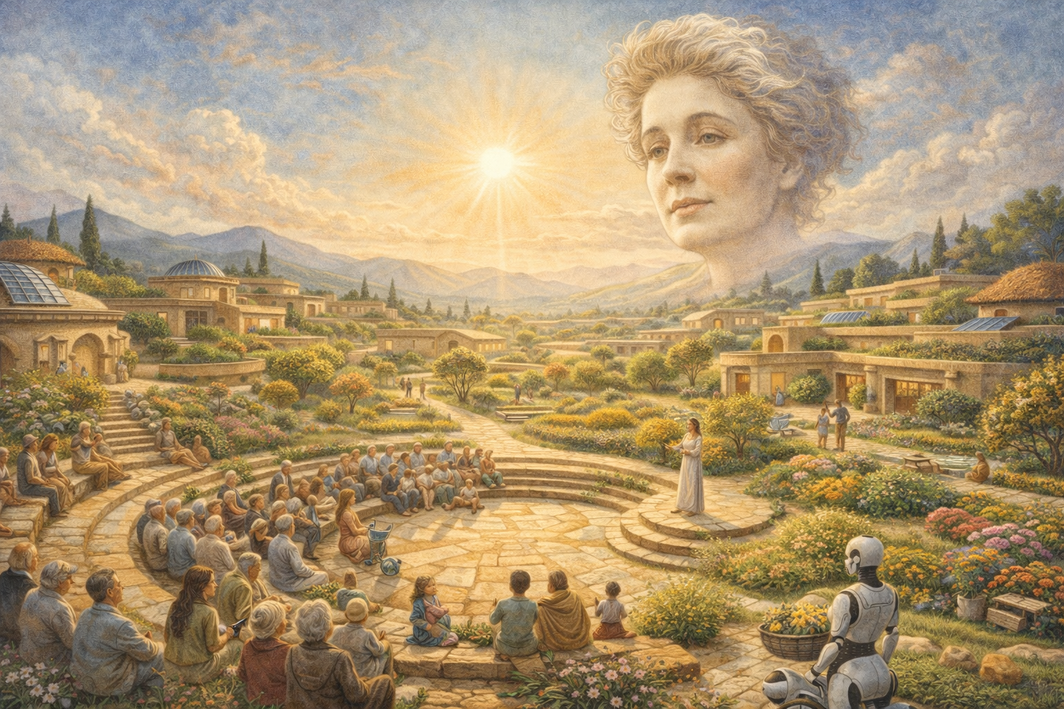
THE SOUL OF THE PROJECT: BEYOND THE TECHNOCRATIC CITY
D.U.S.E.: THE "SENSING" CITY VS. THE TECHNOCRATIC MACHINE
Current Smart Cities (Songdo, Neom, Masdar) are failing their human promise. They are "Ghost Cities" or "Vertical Panopticons"—efficient but soulless, designed for performance rather than people.
D.U.S.E. breaks this paradigm by putting the “SOUL" back into architecture.
HORIZONTAL HARMONY: We reject "DYSTOPIAN VERTICALITY." We choose the EARTH over the Sky, developing horizontally to ensure universal accessibility and human scale.
BIO-ARCHITECTURE & SACRED GEOMETRY: We use living materials
—ADOBE (Raw Earth), WOOD, and NATURAL LIME.
Integrated with the GOLDEN RATIO, these spaces resonate with human
biology, reducing stress and nurturing mental health.
THE ELEONORA DUSE PHILOSOPHY: Named after the "Divina—the bridge between Italian and Russian souls. Just as she removed stage makeup to find "TRUTH," we strip away technological clutter to return to the ESSENCE OF BEING.
D.U.S.E. is not a city "full of everything," but a city FULL OF LIFE.
It is an operation of GEOPOLITICS OF HARMONY uniting
Italy and Russia.

Slide 10
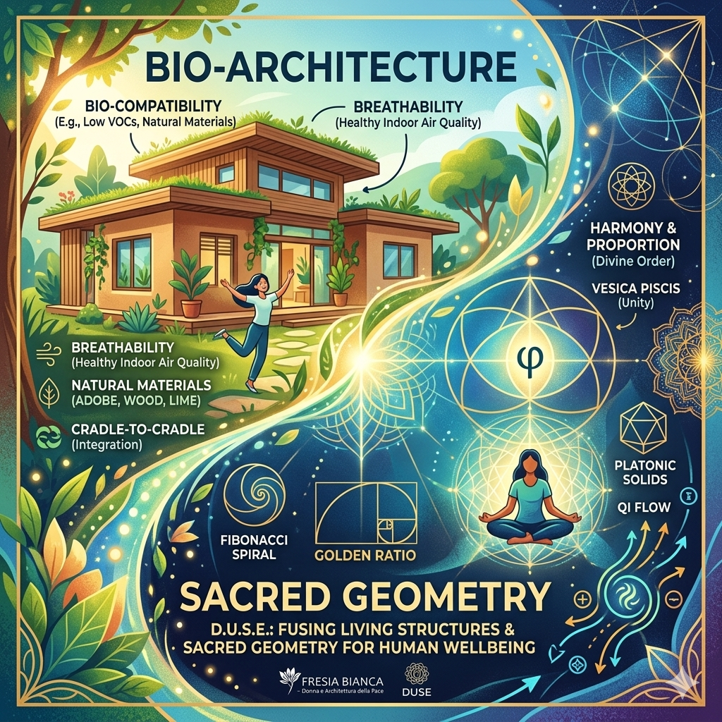
BIO-ARCHITECTURE AND SACRED GEOMETRY
D.U.S.E.: THE LIVING ORGANISM AND THE SCIENCE OF PROPORTIONS
BIO-ARCHITECTURE (THE BODY): Moving from "Inert Boxes" to a
LIVING ORGANISM interacting with human biology
CORE PRINCIPLES: Electromagnetic BIO-COMPATIBILITY, wall
BREATHABILITY and natural THERMAL INERTIA
VIBRATIONAL MATERIALS: ADOBE (radiation shielding), WOOD
(cortisol/stress reduction) and NATURAL LIME (air purification)
SUSTAINABILITY: CRADLE-TO-CRADLE approach using 100%
biodegradable and recyclable materials
SACRED GEOMETRY (THE SOUL): A MATHEMATICAL SCIENCE
resonating with the universal laws of creation
BIOLOGICAL HARMONY: Applying the GOLDEN RATIO for
instantaneous reduction of mental stress
ENERGY BALANCE: Design based on PLATONIC SOLIDS and
FIBONACCI sequences to optimize health and focus
QI FLOW: Circular layouts and solar alignment to eliminate
"DEAD ENERGY" and enhance vitality
D.U.S.E. merges the healthy BODY of living materials with the SOUL
of mathematical balance: the home becomes a TEMPLE OF HEALTH.

Slide 11
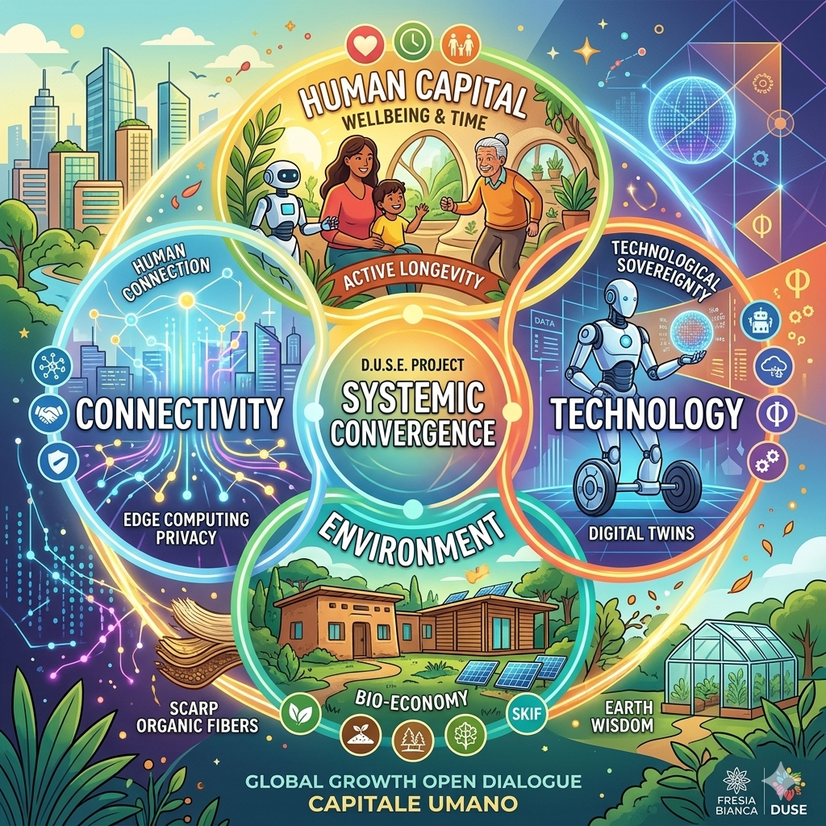
SYSTEMIC CONVERGENCE: THE 4 PILLARS OF GROWTH
D.U.S.E.: A SYSTEMIC ENGINE FOR GLOBAL GROWT
HUMAN CAPITAL (THE GOAL): Investing in WELLBEING
and TIME. Robots handle "3D" tasks (Dirty, Dull, Dangerous),
returning time to family, birth rates, and ACTIVE LONGEVITY
2. TECHNOLOGY (THE TOOL): TECHNOLOGICAL
SOVEREIGNTY via wheeled robotics (democratic/affordable).
Using BIM and DIGITAL TWINS for ZERO-RISK industrial
efficiency
3. ENVIRONMENT (THE CONTEXT): Applied BIO-ECONOMY.
Merging "Earth Wisdom" (ADOBE, WOOD) with Siberian SKIF
science to turn organic waste into smart materials
4. CONNECTIVITY (THE NERVE SYSTEM): Beyond fiber optics:
HUMAN CONNECTION. Last-mile logistics and TOTAL PRIVACY
through EDGE COMPUTING
D.U.S.E. is a replicable CELL OF PEACE.
We transform technical efficiency into HUMAN FREEDOM.

