Slide 1
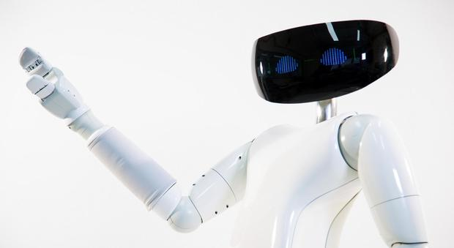
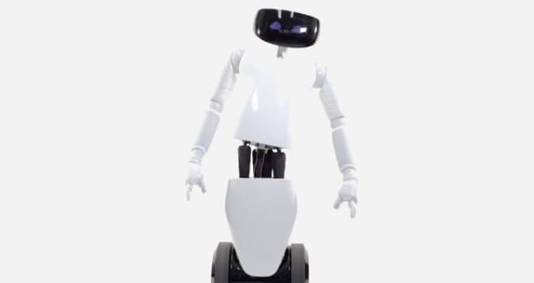
OPEN DIALOGUE 2026
L’ASSISTENTE UMANOIDE NELLA SMART CITY UNIVERSITARIA
The Humanoid Assistant in the University Smart City (USC)
Author
Patrizia Boi

Slide 2
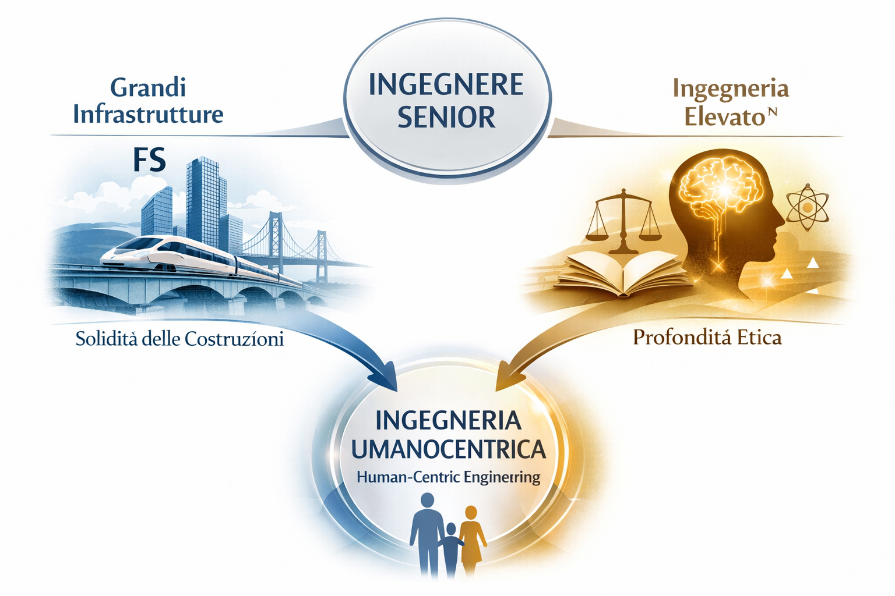
Professional Profile & Vision
Patrizia Boi: Senior Engineer (30+ years experience)
Experience and Pillars
My name is Patrizia Boi and I am a Senior Engineer with over 30 years of experience.
My career rests on two pillars: my long experience at Italian State Railways (FS) and my solid private practice in civil works.
I have focused on reconnecting urban neighborhoods and restoring historic stations.
Engineering and Ethics
Beyond technique, I am a journalist and the author of ‘Engineering to the power n”.
This book analyzes innovation brought by the digitalization of processes and asks a fundamental ethical question: is technology a tool for social harmony or for control?
My vision combines technical background with the need for sustainable growth.
The Project
Today I present the practical application of this vision.
The project 'Humanoid Assistant in the University Smart City’, is designed for well-being and the future of our cities.
Presentazione

Slide 3
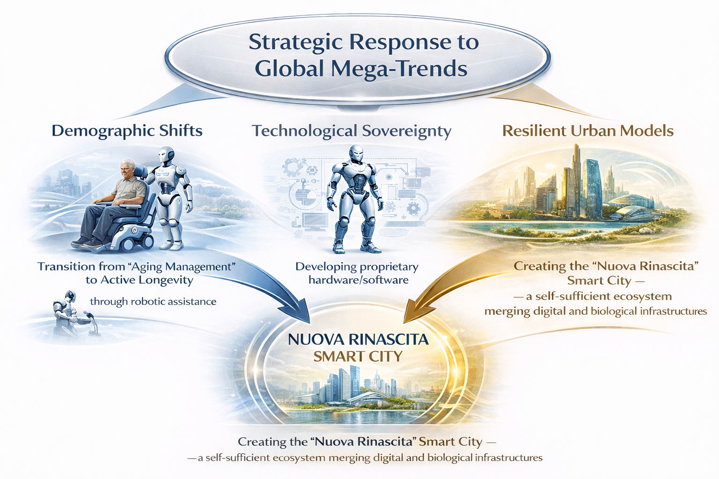
The project actively responds to three of Maxim Oreshkin’s Mega-Trends
1. Demographic Change and Active Longevity
My wheeled assistant is a practical response to aging populations. It supports the autonomy of the elderly in their daily life.
It also helps young families with logistics and child-care, reducing the burden on healthcare and supports birth rates.
2. Technological Sovereignty
To be sovereign, we must develop our own hardware and software, usig simplified, robust mechanics and advanced computer vision.
This makes the nation independent from expensive foreign technologies (like Atlas).
Our goal is a technology that is easy to maintain and locally produced.
3. Resilient Urban Models: "Nuova Rinascita"
The Smart City is the answer to the need for future-ready urban models.
It is a self-sufficient city where digital and biological systems work together.
We use bio-construction to create infrastructure that can withstand global crises.
This is the "New Renaissance" for sustainable and resilient urban life.

Slide 4
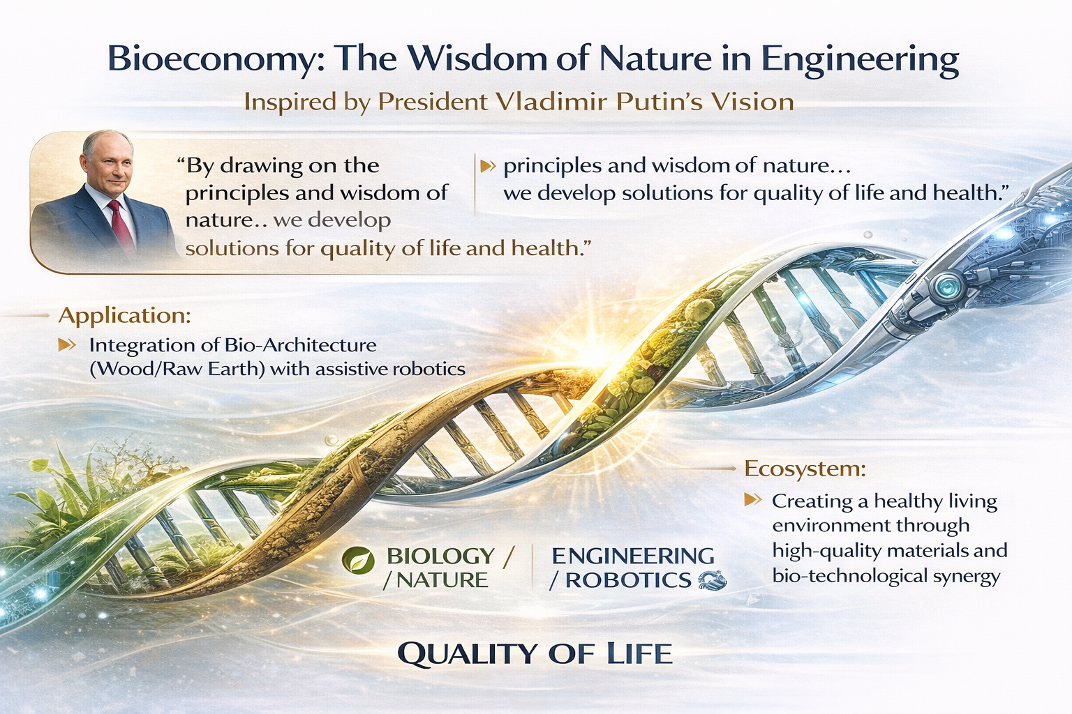
Bioeconomy and the Wisdom of Nature
1. Alignment with the Future Technologies Forum
Our vision fits perfectly with the principles of Bioeconomy.
In this regard, I want to quote President Vladimir Putin, who said:
"Drawing on the principles and wisdom of nature... Researchers and manifacturers are developing solutions that support quality of life, health and active longevity.“
2. Applying the "Wisdom of Nature"
My project applies this vision. The Nuova Rinascita" Smart City is not made of cold concrete; we use natural materials like timber and raw earth.
This is a choice of bio-architecture to protect human health and well-being.
3. A Human-Centered Ecosystem
We combine assistive robotics with biological infrastructure.
This creates an ecosystem that improves daily life and supports the community.
This is the practical application of bio-technological solutions.

Slide 5
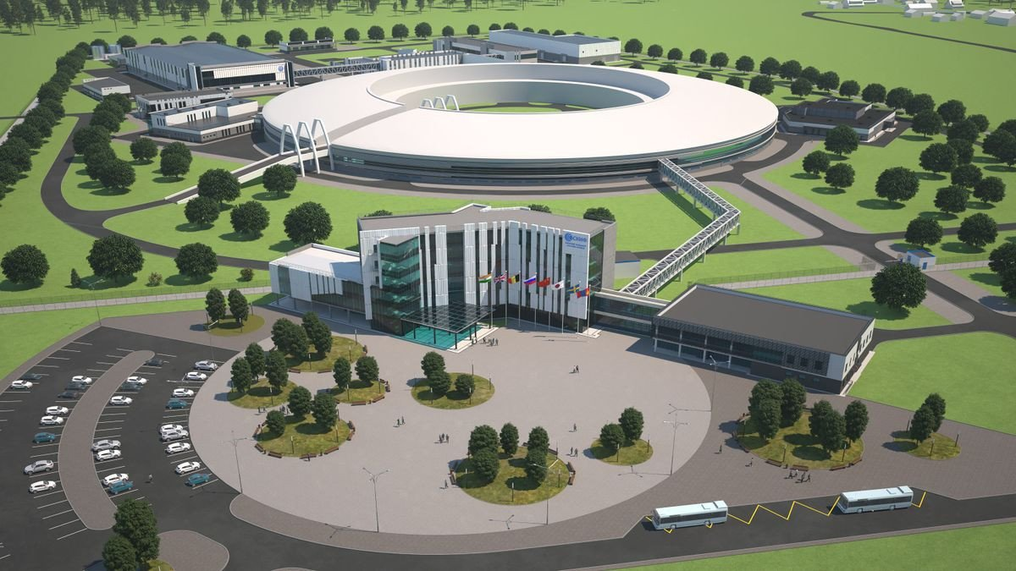
Strategic Integration with Russian Excellence
1. Total Integration for Sovereignty
To ensure true technological sovereignty, we must integrate with Russian excellence, using the research from the Siberian Circular Photon Source (SKIF).
Thanks to SKIF data, we can create world-class bio-composite materials, that will be used for both robot structures and buildings.
2. Biotechnological Engineering Centers
We propose the creation of Engineering Centers within Universities, as we want young Russian minds to transform theory into actual industrial production.
The goal is to bring research from laboratories directly to the Smart Cities.
We are building a bridge between science and the streets.
SIBERIAN CIRCULAR SOURCE OF PHOTONS – MODERN “GREEN” SYNCHROTRON RADIATION SOURCE IN GREEN SIBERIA

Slide 6
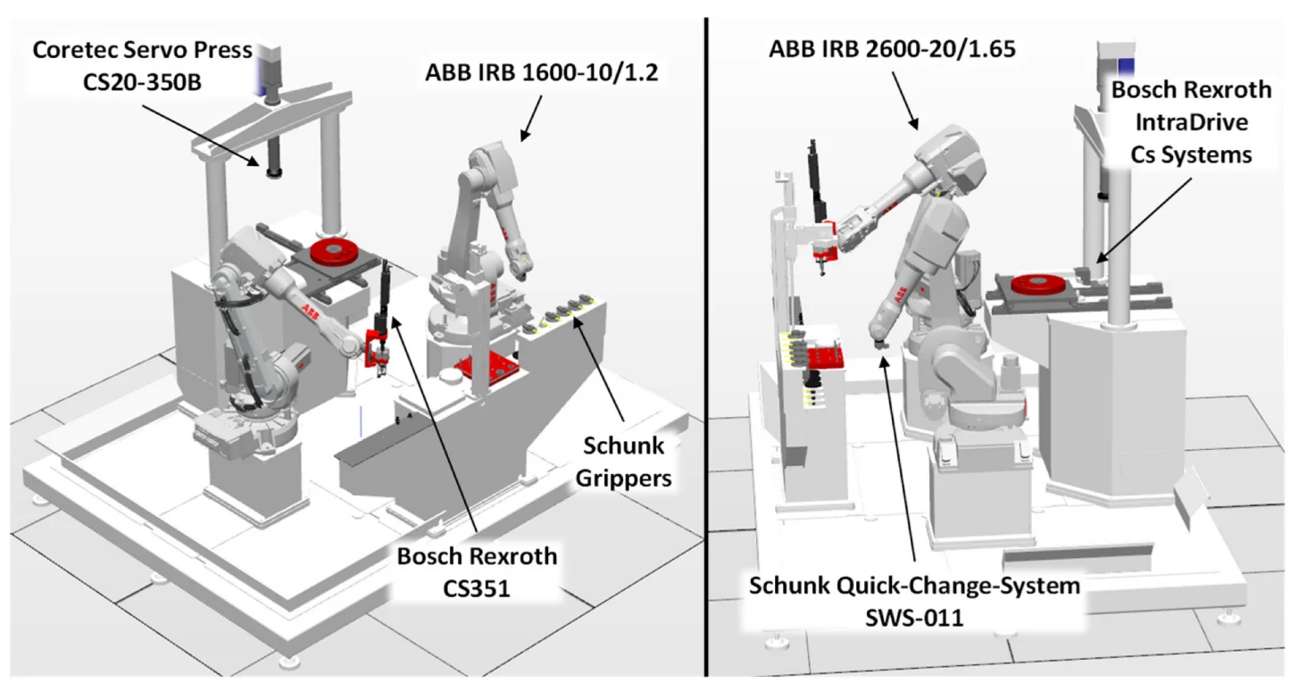
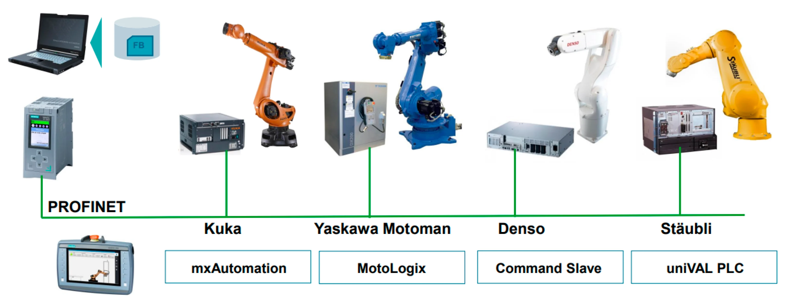
Rigor, Experience & Digital Tools
1. Professional Rigor & Thirty Years of Experience
Managing a project of this magnitude requires absolute rigor.
I bring the same expertise I acquired in thirty years of large-scale railway and civil works.
In this project, we will leave nothing to chance.
2. Advanced Digital Modeling (5D BIM)
We will use 5D BIM modeling and Virtual Commissioning.
This allows us to test the entire "robot-environment" system digitally.
We guarantee effectiveness before laying the first stone.
3. From Digital Design to Reality
We are not just talking about engineering; we are building a new world.
Everything is digitally designed to function perfectly in reality.
This is the bridge between innovation and execution.
Engineering Method and Tool for the Complete Virtual Commissioning of Robotic Cells

Slide 7
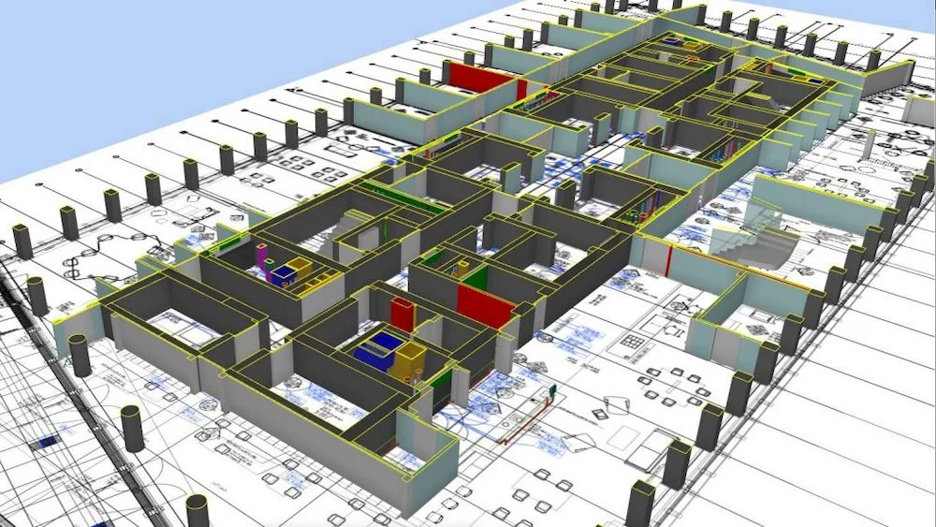
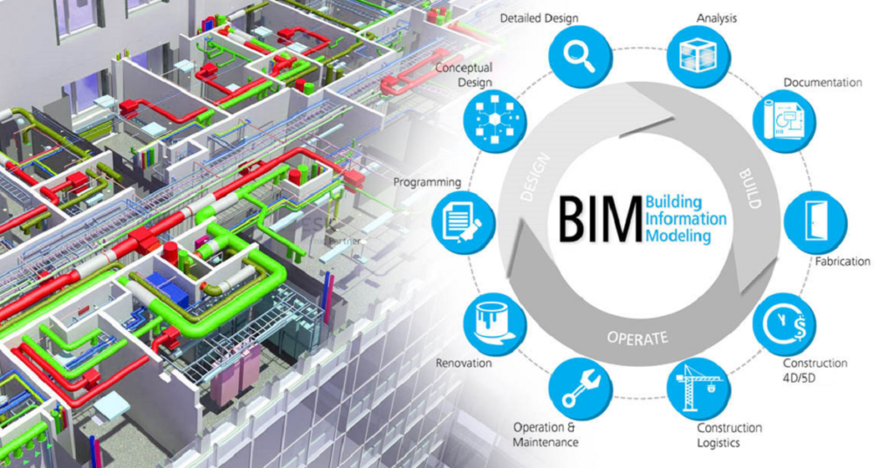
BIM MODELING
Digital Innovation: BIM & Virtual Commissioning
1. What is 5D BIM? (Building Information Modeling)
It is not just a 3D drawing; it is a digital twin of the project.
The "5D" adds two critical layers: Time (schedule) and Cost (budget).
It allows us to manage every detail of the Smart City in a single digital model.
2. What is Virtual Commissioning?
It is a digital simulation of the robot working in its environment.
We test the software and the hardware virtually before the physical build.
This identifies potential problems early, saving time and reducing risks.
3. The Main Benefit
We can guarantee that the humanoid assistant and the city infrastructure work together perfectly.
We solve issues in the digital world so they don't happen in the physical world.
VIRTUAL COMMISSIONING

Slide 8
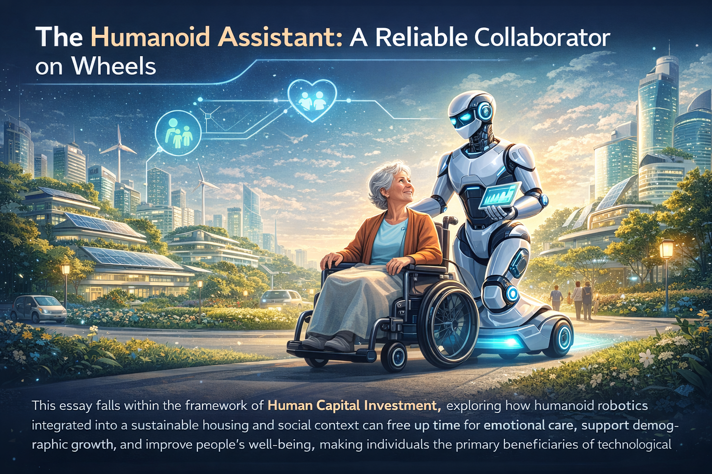
The Humanoid Assistant – A Reliable Wheeled Collaborator
1. Investment in Human Capital
This project is at the heart of Investment in Human Capital.
We explore how humanoid robotics can be integrated into a sustainable social habitat.
The goal is to use technology to serve people, not the other way around.
2. Three Fundamental Goals
Free up time: Our robot handles logistics to allow more time for affective care.
Support demographic growth: It assists young families, reducing the daily burden.
Improve general well-being: It creates a healthier and more supportive environment.
3. People-Centered Progress
We want people to be the true beneficiaries of technological progress.
This is a practical application of robotics for social harmony.
We are building a city that supports life and growth.

Slide 9
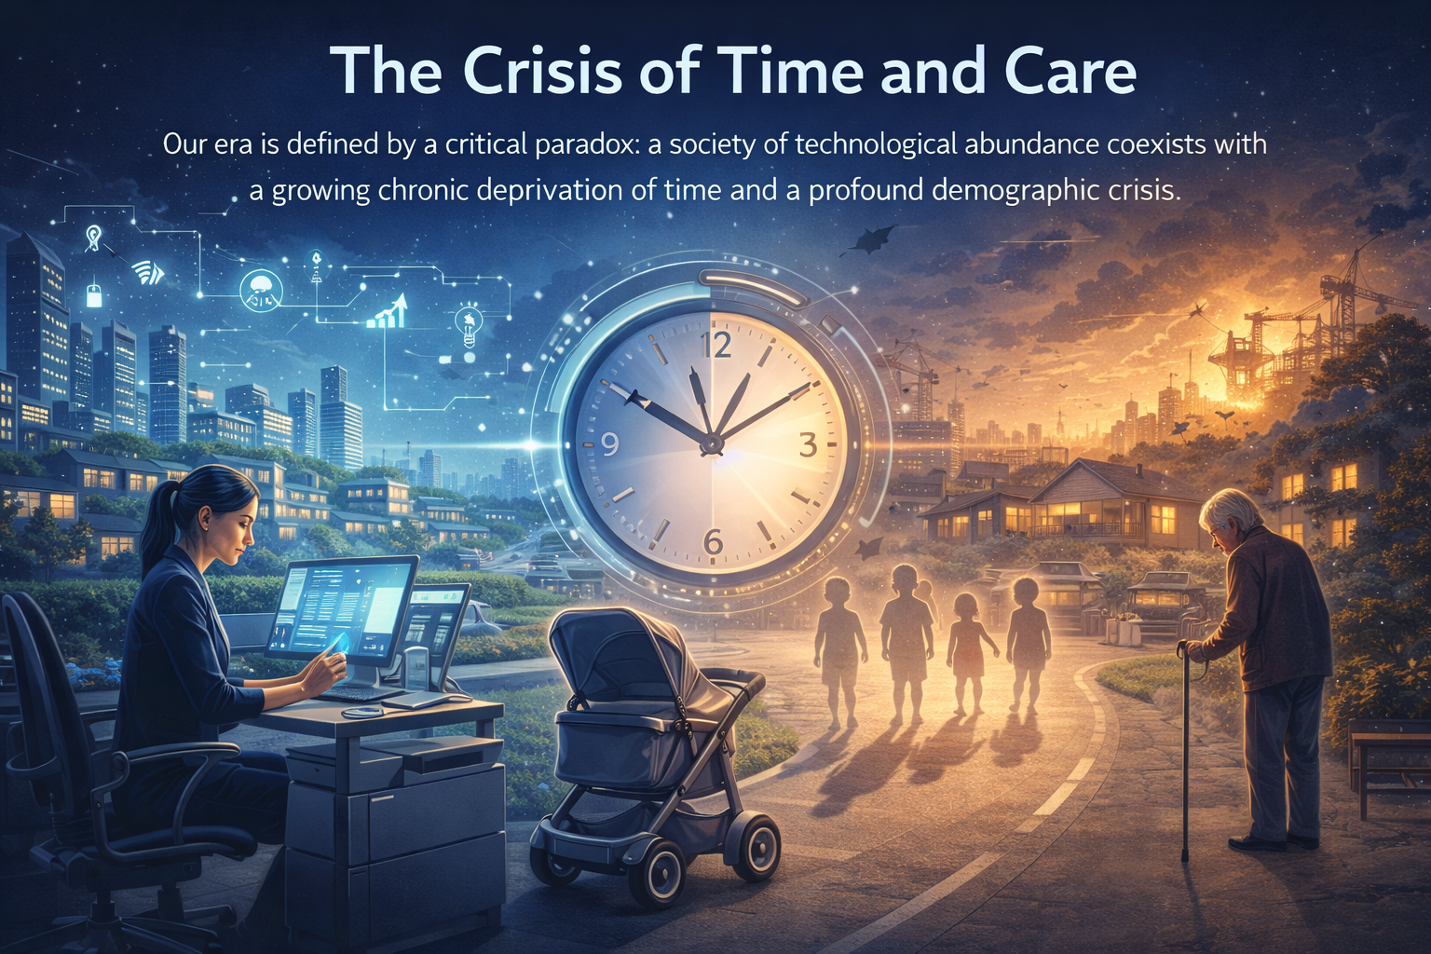
The Paradox of Our Era
1. Technological Abundance vs. Time Poverty
We live in a paradox: we have great technology, but no time.
Modern work rhythms create barriers to starting new families.
The age for a first child is rising due to professional and economic obstacles.
2. The Demographic Crisis
Average life expectancy is increasing, but the elderly are lonely.
There is a growing need for daily assistance that the current system cannot provide.
This is a systemic shortage that affects both the young and the old.

Slide 10
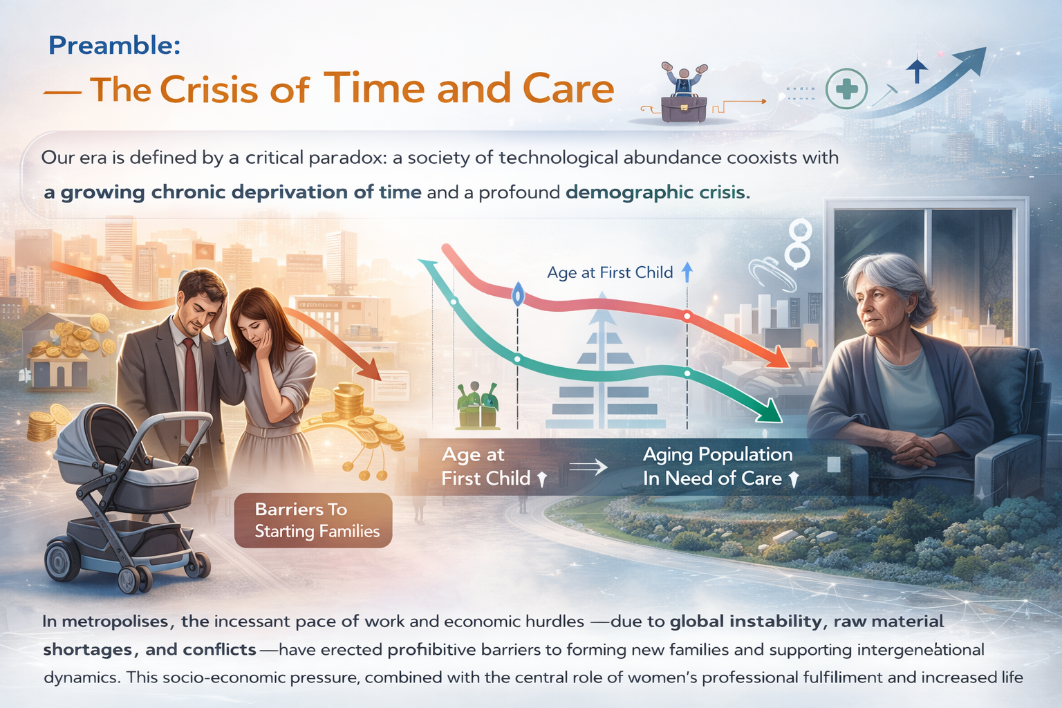
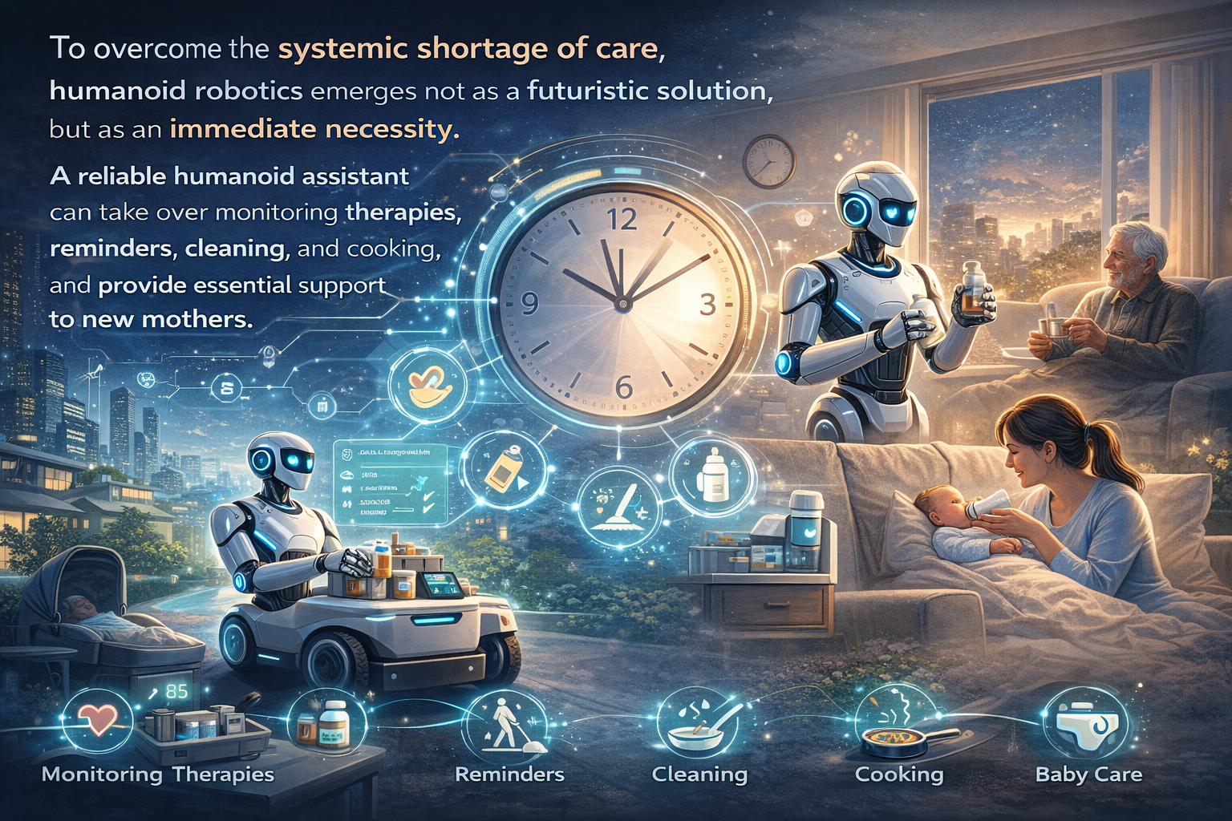
Robotics as a Social Necessity
1. Delegating Daily Tasks
Humanoid robotics is no longer a dream; it is a social necessity.
A reliable assistant can take over crucial daily operations:
Health: Monitoring and therapy reminders.
Home: Cleaning and cooking.
Families: Support for new mothers with household chores.
2. Technology Frees Affection
The goal is to restore time and energy for affective care.
Robotic assistance does not replace human love.
Technology frees human affection by removing the burden of chores.

Slide 11
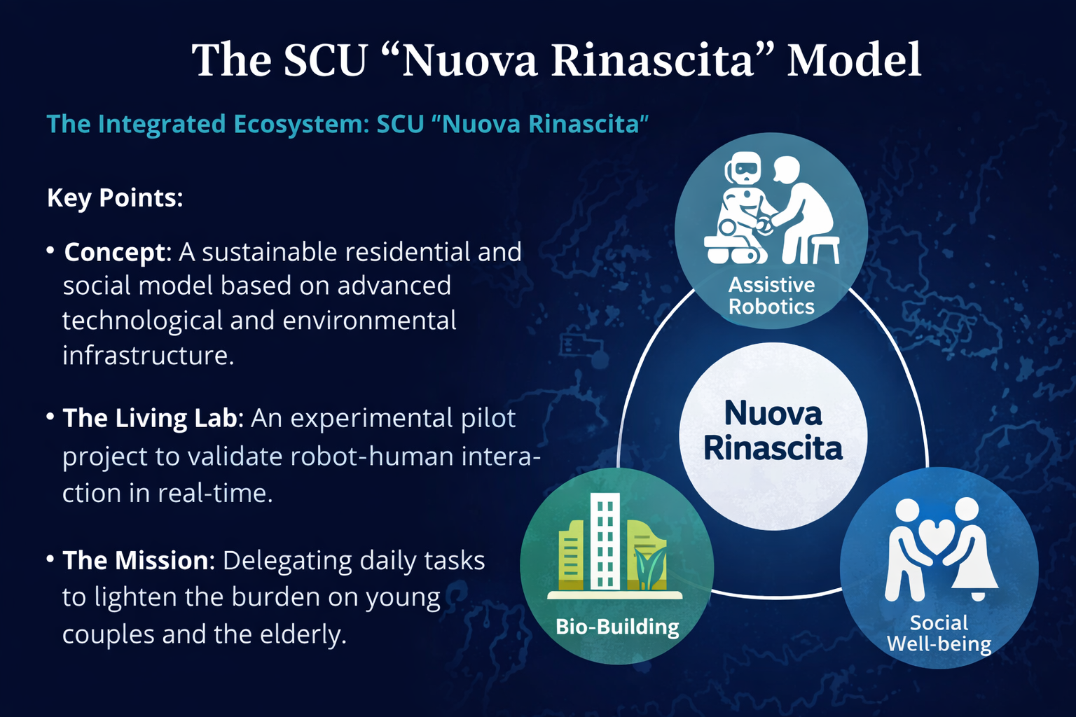
The "Nuova Rinascita" Smart City (SCU)
1. An Integrated Housing and Social Model
To respond to the crisis, I propose the 'Nuova Rinascita' University Smart City.
This city is a 'living lab' for sustainable and technological living.
It is a place where technology and human needs work together.
2. The Role of the Humanoid Assistant
Our 'reliable wheeled collaborator' is the primary tool in this city.
The goal is to lighten the daily load for young couples and the elderly.
We are creating an environment that supports families and active longevity.

Slide 12
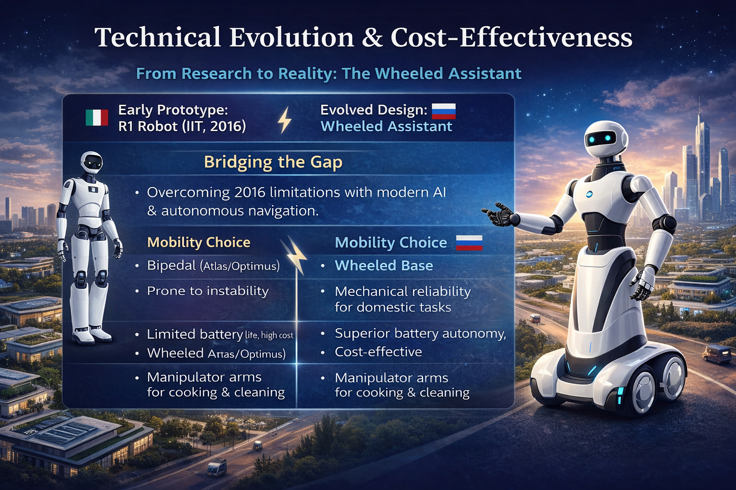
The Evolution of the Domestic Humanoid
1. Rooted in Italian Research Excellence
This vision started in 2016 with the R1 robot (IIT Genoa, Giorgio Metta).
Today, thanks to AI progress, we can overcome past limitations.
We are building on a solid foundation of Italian innovation.
2. Why Wheels Instead of Legs?
We chose a rotating base (wheels) with a torso and manipulator arms.
Cost-Effectiveness: It is much cheaper than bipedal models (like Atlas or Optimus).
Stability and Autonomy: Wheels offer superior balance and longer battery life.
It is a practical and efficient solution for real-world use.

Slide 13
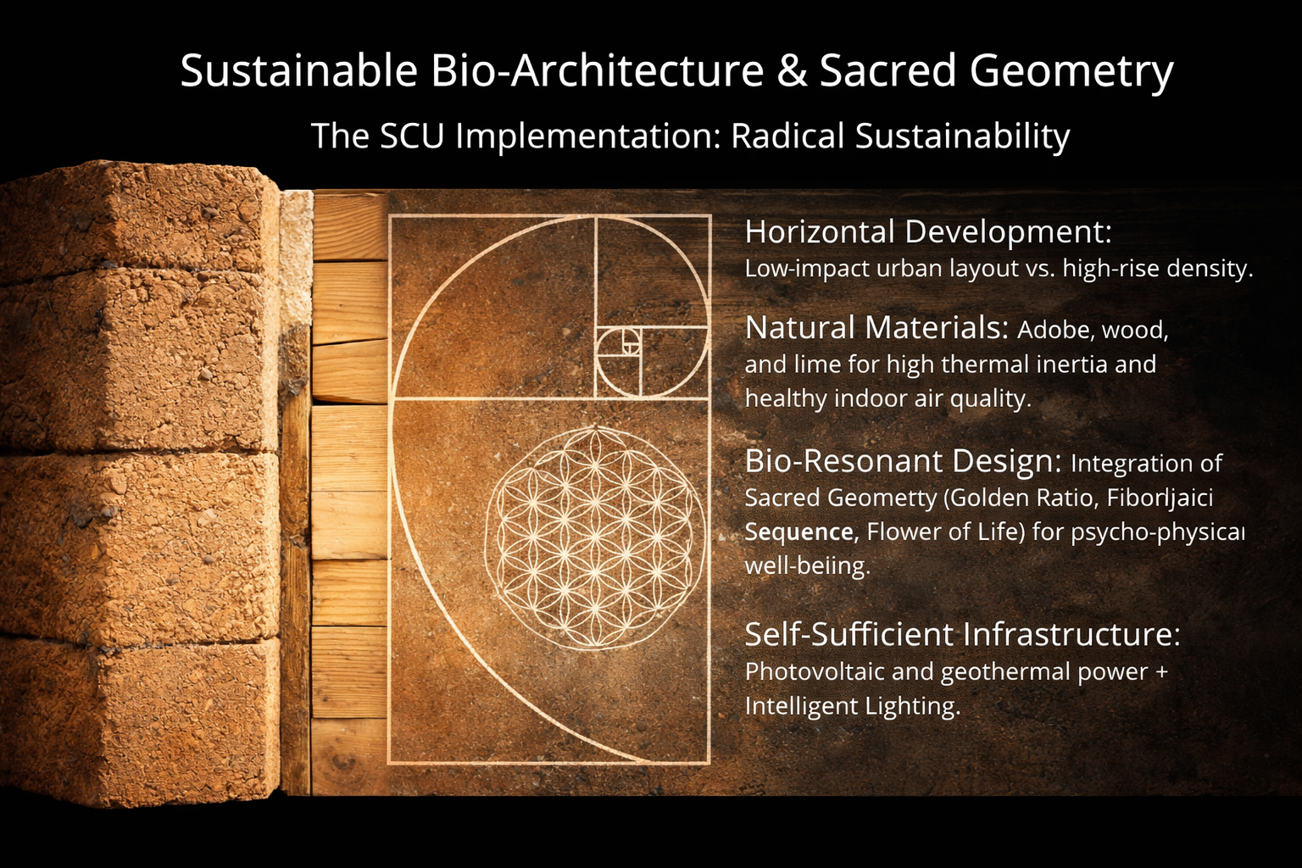
Architecture and Sacred Geometry
1. Principles of Radical Sustainability
The City develops horizontally, not vertically, for a human scale.
We use natural materials: Adobe, Timber, and Lime.
These materials guarantee high thermal inertia and healthy environments.
2. The Design: Sacred Geometry
Our design follows the principles of Sacred Geometry.
We use the Golden Ratio, the Vesica Piscis, and Platonic Solids.
These proportions are not just aesthetic; they elevate well-being.
We build spaces that support the psycho-physical health of inhabitants.

Slide 14
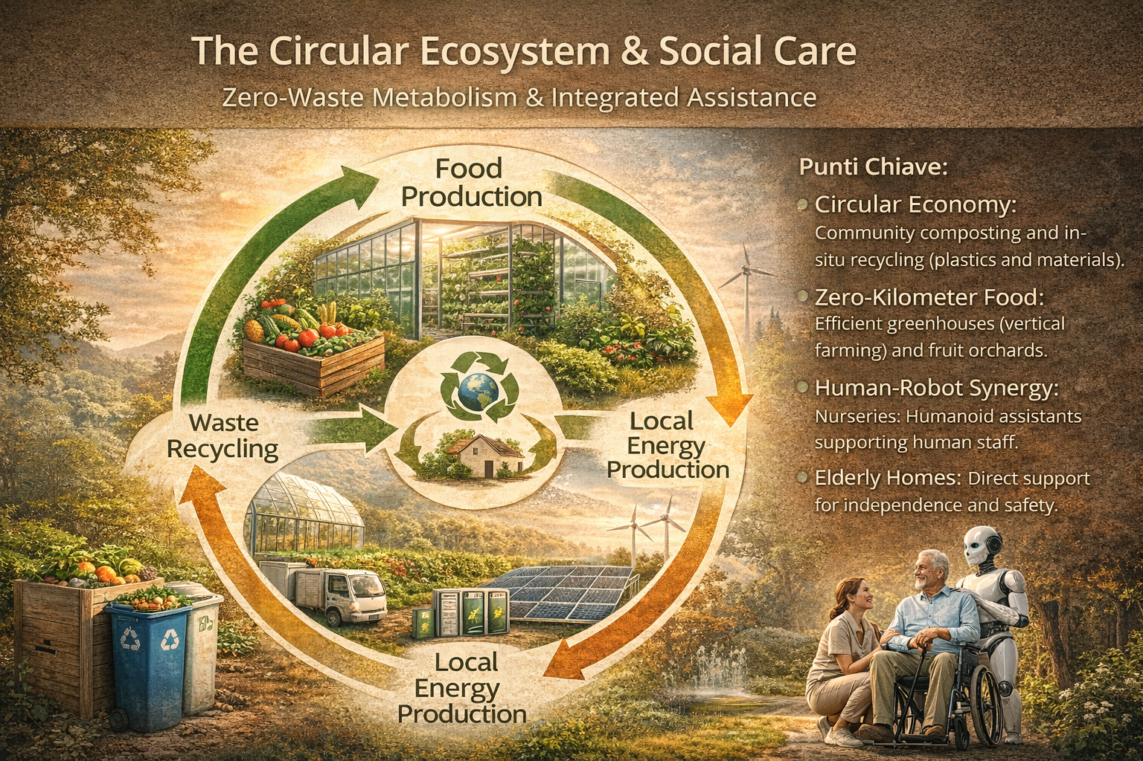
Self-Sufficiency
Infrastructure and Zero Waste
The city is self-sufficient via photovoltaic and geothermal systems.
We aim for 'Zero Waste' with community composting and recycling.
Local Food: Vertical greenhouses and fruit gardens at "zero kilometers".

Slide 15
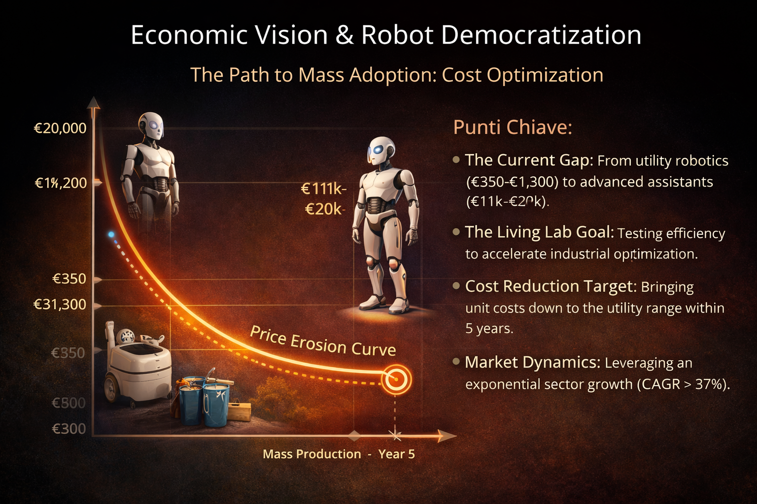
Technological Democratization
Today, a humanoid assistant costs between 11,000 and 20,000 euros.
Our Goal: Bring the cost down to the level of a vacuum cleaner within 5 years.
We leverage the sector's exponential growth of 37% annually.
Making technology affordable for everyone is our mission.

Slide 16
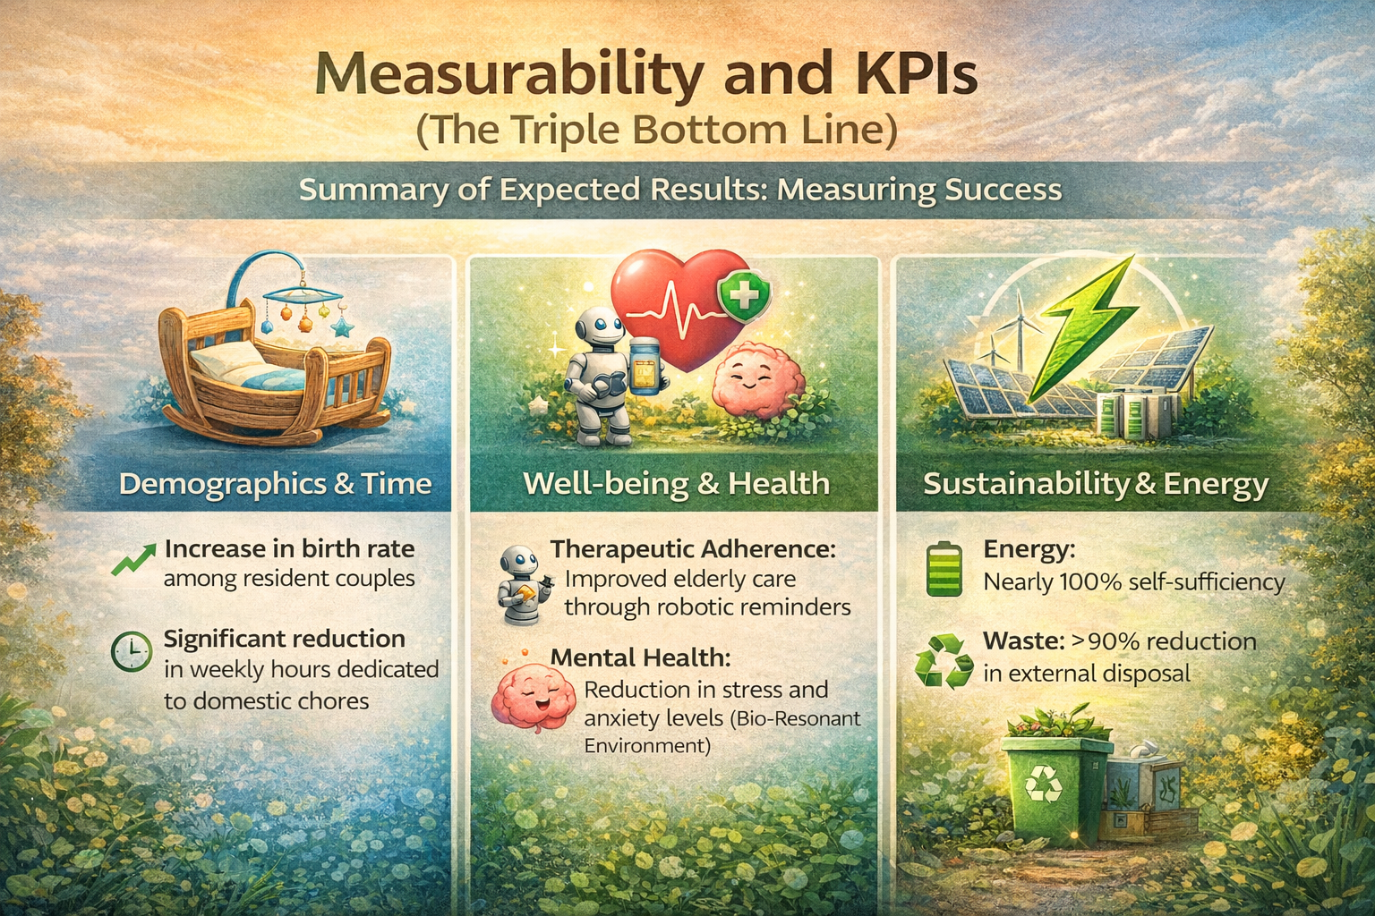
Summary of Expected Results
1. Demography and Time
We expect an increase in the birth rate among young resident couples.
This is possible by liberating domestic time and providing robotic assistance.
Success is measurable through the activity and support of the robots.
2. Well-being and Health
We aim for a significant improvement in therapy adherence for the elderly.
Environments built on natural harmony will reduce stress and anxiety.
The goal is a measurable increase in the psycho-physical health of inhabitants.
3. Sustainability and Economy
100% Energy self-sufficiency via renewable sources.
90% reduction in external waste through in-situ recycling.
A resilient and replicable model for the future of the nation.

Slide 17
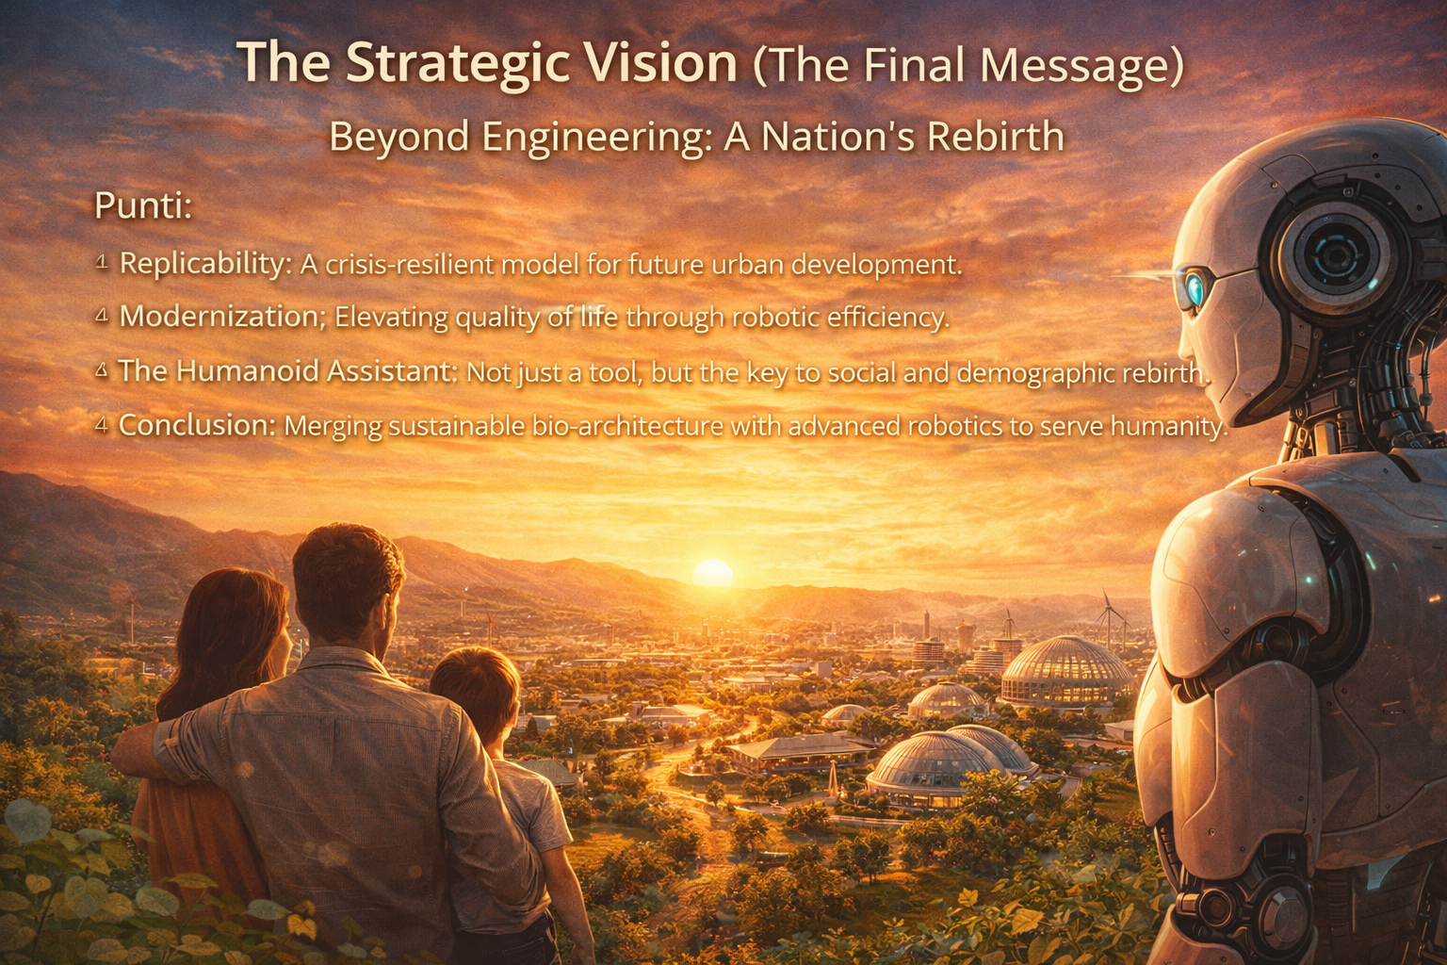
Conclusion & Vision
The Key to Our Future
The Humanoid Assistant is the heart of a new social model.
Combined with sustainable bio-construction, it is the solution.
Our goal is the social and demographic rebirth of the nation.
Building a New World Together
Technology does not replace human love; it frees it.
We are creating a city designed for human well-being.
This is the "Nuova Rinascita" (New Renaissance).

Slide 18
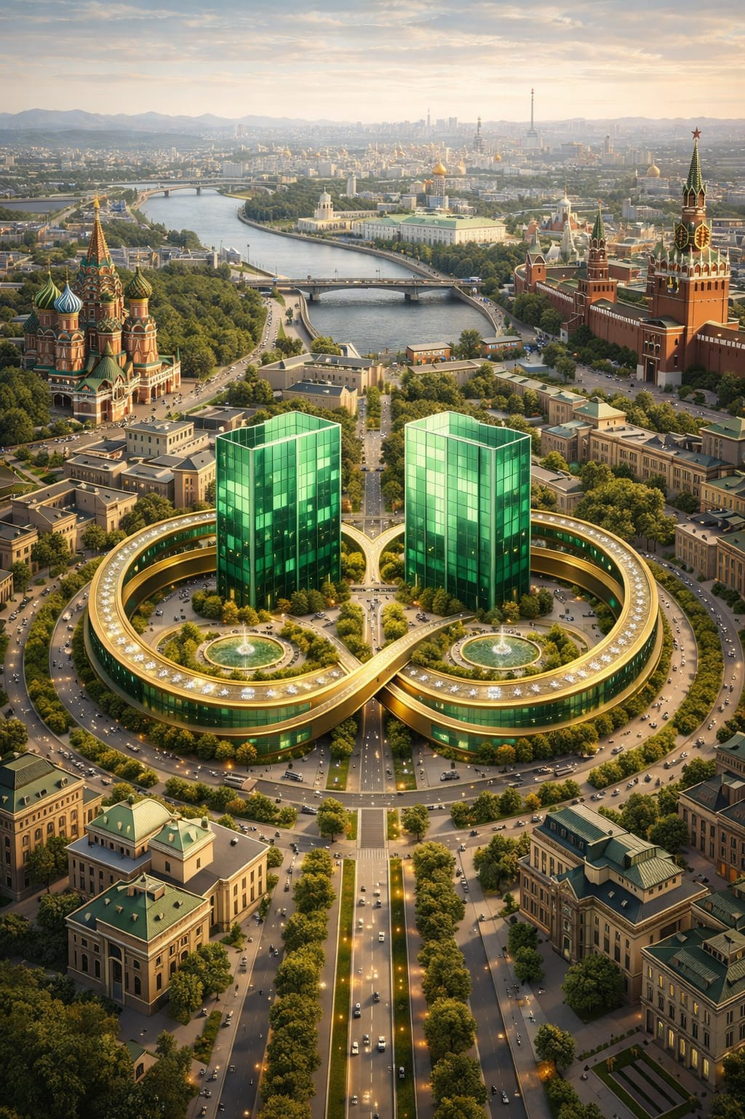

D.U.S.E. – Dipartimento Universitario Sostenibilità Evoluzione
Verso una nuova Smart City: Dove la Tecnologia incontra l'Anima
(Internazionale): Department for Urban Sustainability & Evolution
Symbolic Dedication
If this project happens, it will be dedicated to Eleonora Duse, the 'Divine.’
A legendary Italian actress, loved at home and adored in Russia, she brought a modern touch to the stage that moved the whole world. She was a symbol of change and deep feeling.
We named our department D.U.S.E. (Department for Urban Sustainability & Evolution) after her. Our goal is a Smart City that isn't just hardware and sensors, but a place that feels alive and welcoming.
The two emeralds from her famous ring will inspire us: the strength of the stone for our buildings, and its beauty for the people's quality of life.

Slide 19
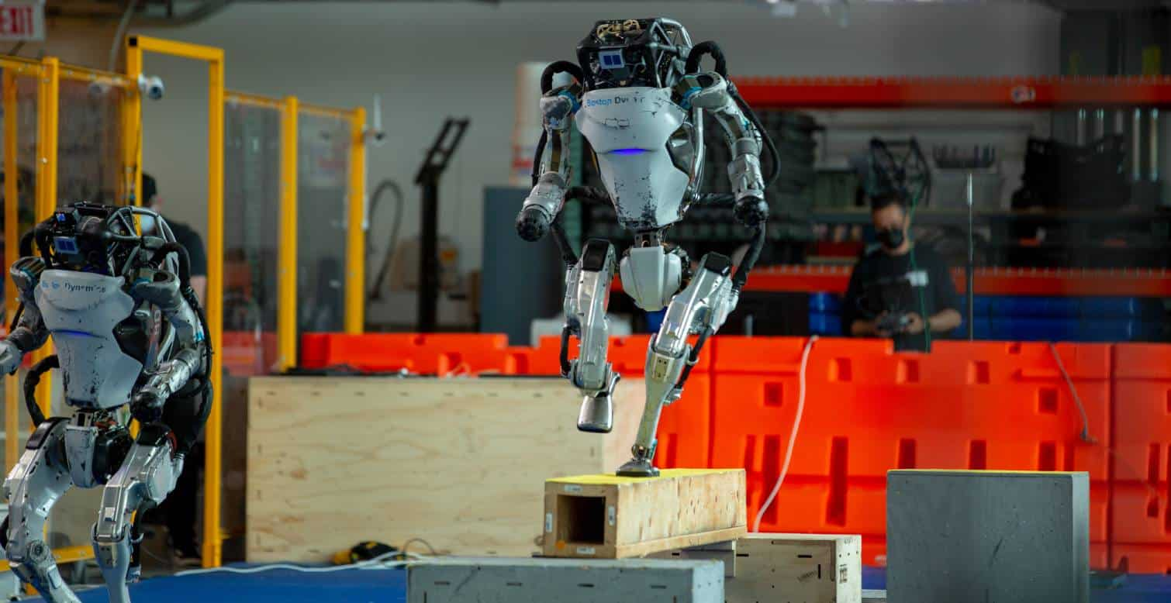
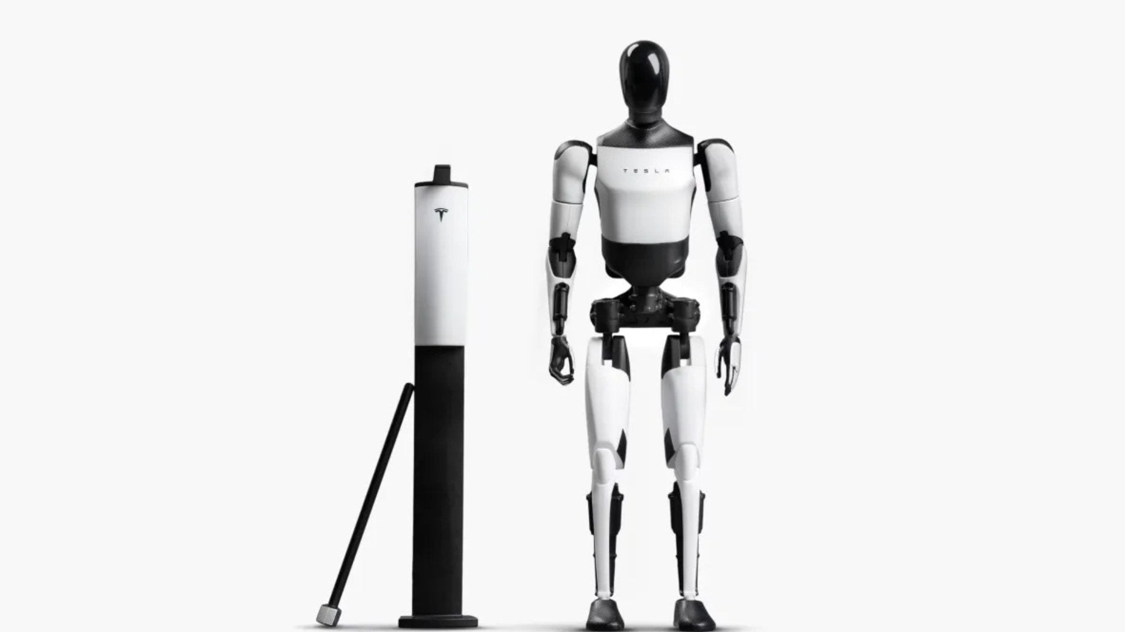
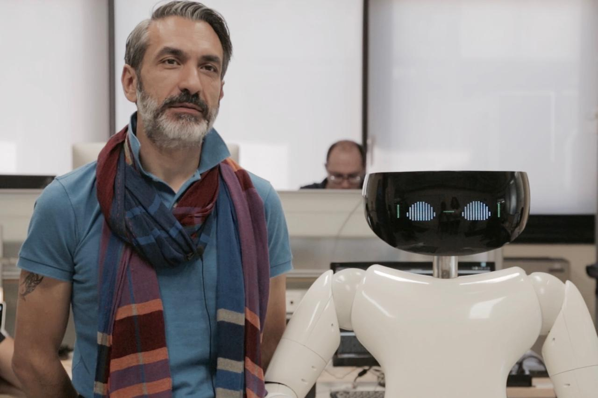
Atlas
Optimus
ATLAS: The R&D Athlete – High complexity, high cost, limited autonomy.
OPTIMUS: The Industrial Appliance – Mass production, simplified mechanics, AI-driven.
OUR PROJECT: The Practical Collaborator – Immediate stability, bio-integrated safety, cost-effective for urban ecosystems.
R1, nato nel 2016 da Giorgio Metta (ITT GENOVA), il primo robot IIT per applicazioni in ambito domestico e professionale

Slide 20
Phase | Macro-Operation | Level of Detail / Key Output
PHASE 1 | Feasibility Study & Site Selection | Geotechnical, climatic, and regulatory analysis. Preliminary cost assessment (CAPEX/OPEX).
PHASE 2 | Preliminary Design & Team Building | Definition of urban layout (Sacred Geometry). Partnerships with luminaries (Metta, Russian/Chinese experts).
PHASE 3 | Final Design & BIM Modeling | Integrated BIM modeling. Design of smart systems (geothermal, photovoltaic, smart lighting).
PHASE 4 | Executive Design & Virtual Commissioning | Construction details and technical specifications. Virtual simulations of robot-environment interaction.
PHASE 5 | Financing & Approvals | Presentation of the Business Plan to investors/institutions. Permitting and funding approval.
PHASE 6 | Construction & Project Management | Green building construction (wood, adobe). Digital infrastructure integration and robot deployment.
PHASE 7 | Technical-Administrative Testing & Start-up | Final commissioning. Launch of the Pilot Project with the first residents (young couples and elderly).
Organizational Structure & Global Talent
1. Multidisciplinary Expert Staff
Managing this project requires a world-class multidisciplinary team.
We will involve top experts in robotics, following the excellence of leaders like Giorgio Metta.
The team includes high-quality engineers and architects specialized in bio-construction and AI.
2. Global Strategic Collaboration
We select the best minds from Russia, China, India, and Iran. This international cooperation ensures differents expertise and technological sovereignty.
We combine different technical cultures to create a universal solution for the Smart City.
3. Advanced Technological Support
The project relies on high-technology tools for every phase.
We use AI-driven design and advanced simulation to optimize the robot-environment interaction.
Our goal is to integrate frontier science with practical, large-scale engineering.
Project Roadmap: University Smart City (SCU) "Nuova Rinascita"

Slide 21
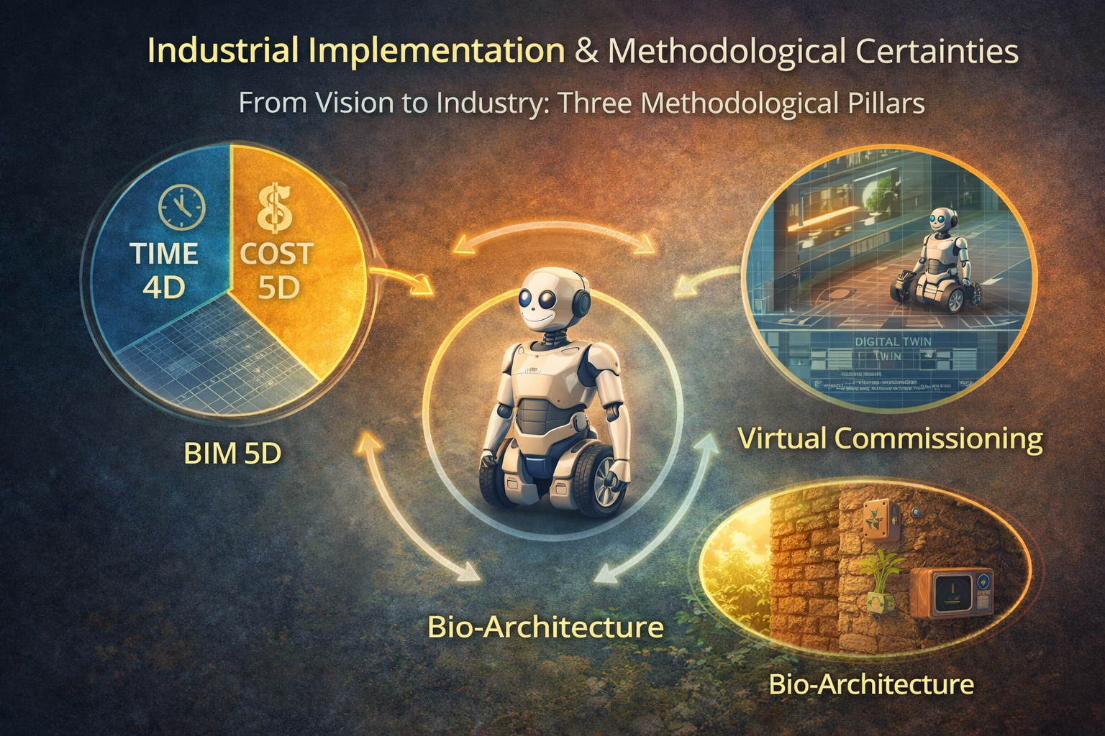
From Vision to Industry – Three Methodological Pillars
1. BIM Method (4D/5D): Digital Management
We use BIM for the full digital management of costs and timelines.
The robot is not an extra; it is an integrated element of the design from day one.
This ensures that the architecture and the technology grow together perfectly.
2. Virtual Commissioning: Zero-Risk Testing
We utilize the Digital Twin technology for comprehensive, zero-risk testing.
This guarantees operational efficiency before the physical construction begins.
We test the robot-environment interaction in a safe, virtual world.
3. Energy Resilience: Self-Sufficiency
The Smart City is a self-sufficient organism built with natural materials.
Robotic intelligence is used to optimize resources instead of consuming them.
This is our secret to building a truly sustainable and resilient future.

Slide 22
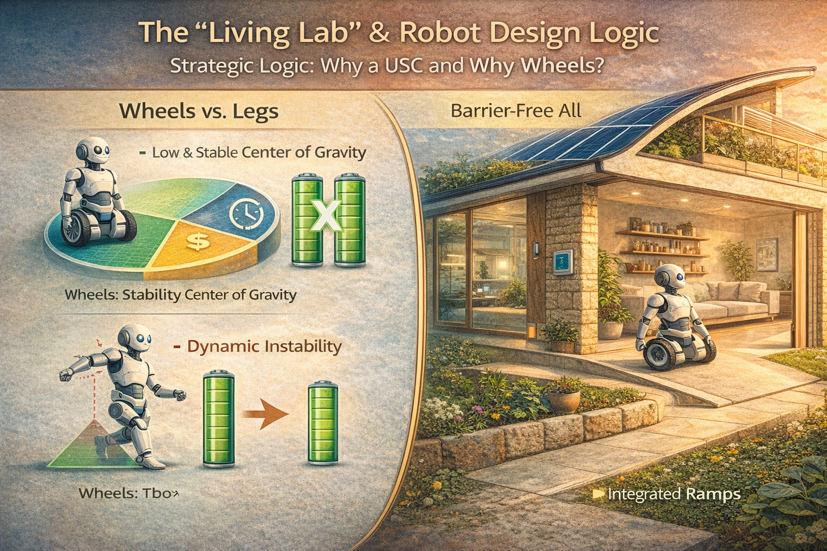
The "Living Lab" & Robot Design Logic
1. The University Smart City (USC)
A "Living Lab": We test and prove technology where future leaders are born.
A seed sown in the most fertile ground for global progress.
The city becomes a real-world stage for innovation and research.
2. Strategic Choice: Wheels vs. Legs
Wheels: We guarantee superior stability, lower maintenance, and 3x the battery life compared to bipedal robots.
The Philosophy: It is smarter to design a barrier-free environment (Design for All) than to build an unstable, expensive bipedal robot.
Efficiency and accessibility are the keys to large-scale implementation.

Slide 23
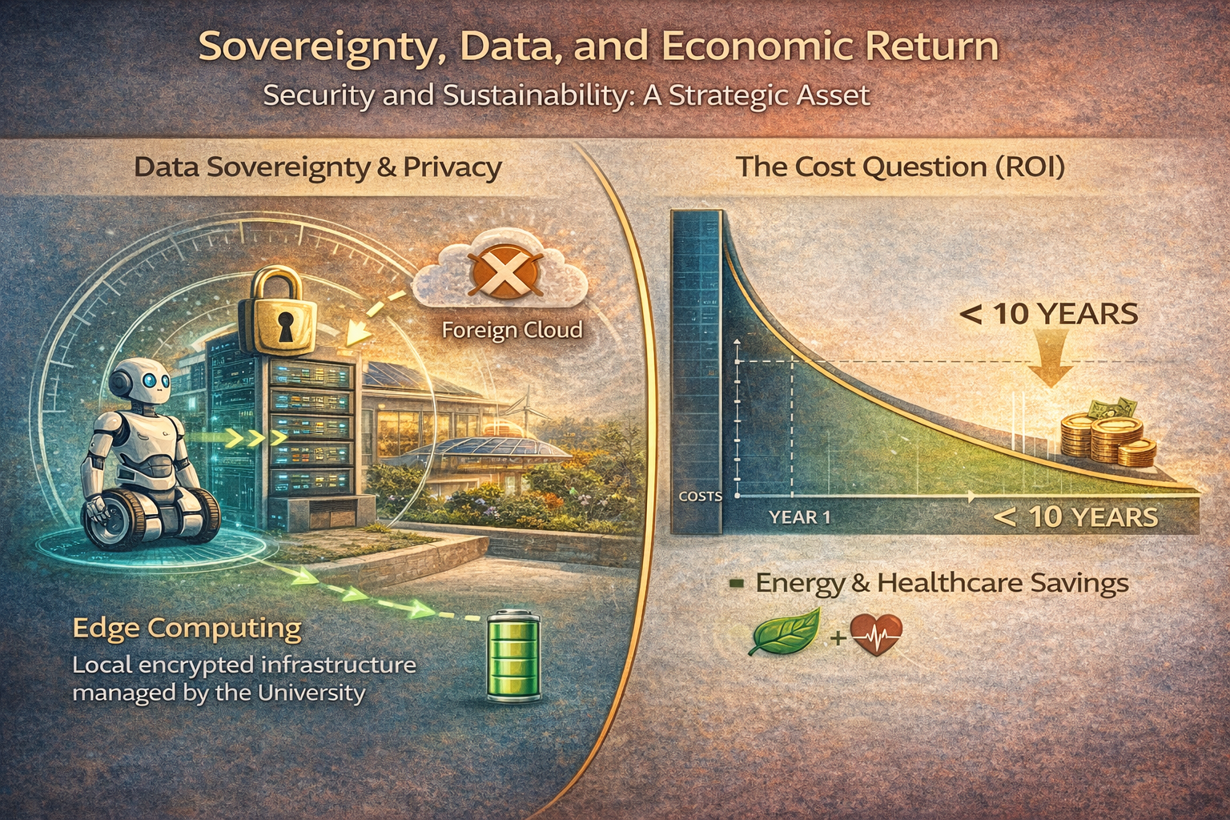
Sovereignty, Data, and Economic Return
1. Data Sovereignty & Privacy: A Strategic Asset
Edge Computing: All data is processed on-board the robots, never in foreign clouds.
Local Infrastructure: We use an encrypted network managed directly by the University.
Security First: We guarantee total privacy and national technological control.
2. The Cost Question: Return on Investment (ROI)
Economic Sustainability: The initial investment is amortized in less than 10 years thanks to BIM 5D calculations.
Energy Savings: High efficiency and bio-construction significantly reduce management costs.
Social Impact: "Active Longevity" programs lead to a measurable reduction in national healthcare spending.
3. Conclusion: A Resilient Legacy
We are building more than a city; we are protecting data and future generations.
This is a profitable, secure, and sovereign model for the 21st century.

Slide 24
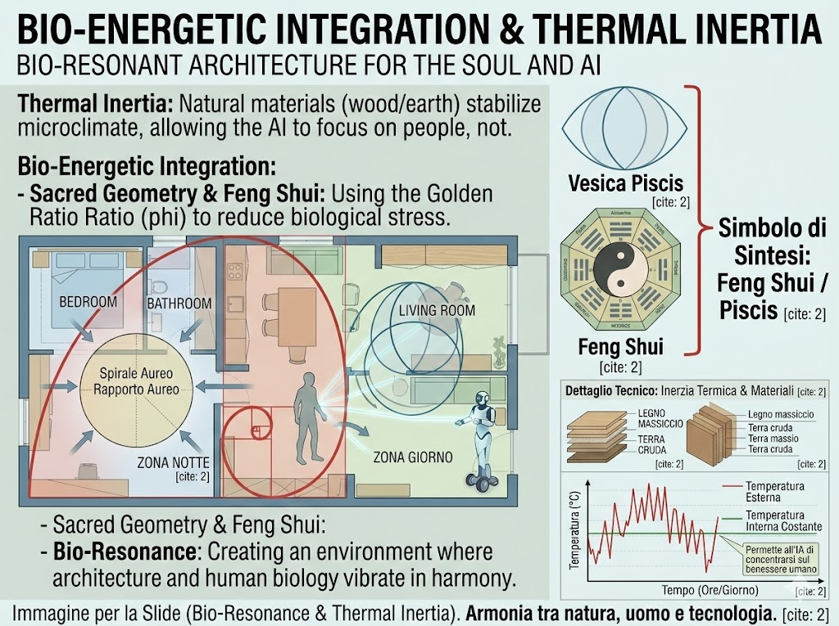
Bio-Resonance: Architecture for the Soul and AI
1. Thermal Inertia: Natural Microclimate Control
We use natural materials like wood and earth to stabilize the indoor microclimate.
This allows the AI to focus its energy on helping people rather than managing climate control systems.
High thermal inertia creates a healthy and stable environment for both humans and sensors.
2. Sacred Geometry & Biological Harmony
The design follows the Golden Ratio (phi) and principles of Feng Shui to reduce biological stress.
We create a Bio-Resonant environment where architecture and human biology vibrate in harmony.
These ancient proportions help inhabitants achieve a state of natural well-being.
3. The Synergetic Result
Architecture is no longer a passive space; it becomes a supportive habitat.
By reducing physical and mental stress, we improve the effectiveness of the Humanoid Assistant.

Slide 25
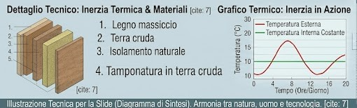
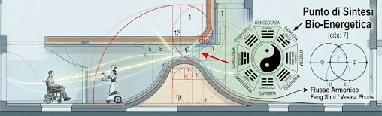
Inclusion & "Design for All"
1. Beyond Aging: A Barrier-Free Society
The same infrastructure that supports the elderly provides total autonomy for people with disabilities.
By removing barriers for our wheeled assistant, we create a world where a wheelchair and a robot move with equal dignity.
We don't fix the person; we fix the environment and provide the tool to master it.
2. The Humanoid as "The Equalizer"
Personalized motor and cognitive support for every inhabitant.
A "constant companion" that never tires, ensuring safety and social interaction.
Technology becomes the bridge between limitation and independence.
3. Our Philosophy
A "Design for All" Ecosystem: where efficiency meets empathy.
This is the final step toward a truly inclusive society.

Slide 26
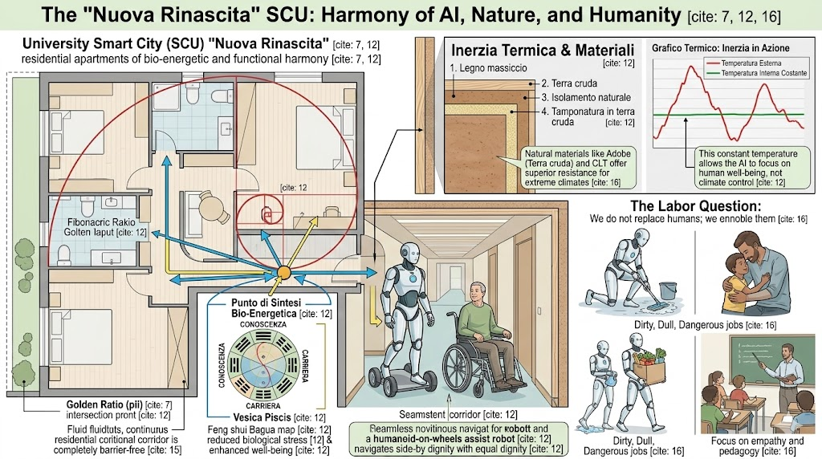
Resilience and Ethics: The Hard Questions
Safety, Ethics, and the Human-Robot Synergy
We provide concrete answers to the most challenging concerns of our future:
Blackout & Connectivity: Through Energy Independence, geothermal and solar power ensure the city stays "on," while Edge Computing allows the robot to perform vital functions without an internet connection.
The Labor Question: We do not replace humans; we ennoble them. Robots handle "3D" jobs (Dirty, Dull, Dangerous), allowing caregivers to focus on empathy and pedagogy.
Material Resistance: Using CLT (Cross-Laminated Timber) and Adobe offers superior fire resistance and insulation, even in extreme climates from Siberia to the Arctic.

Slide 27
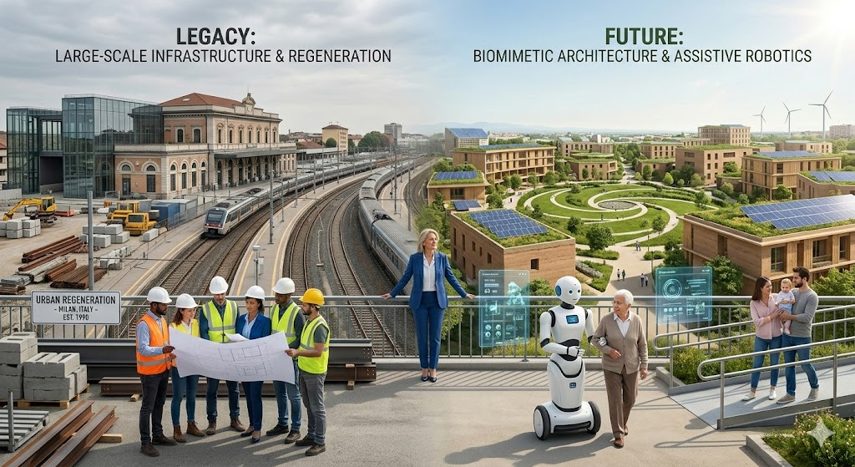
«This image represents my way: from the Legacy of large-scale infrastructure to a Future of biomimetic sinergy.»

Slide 28
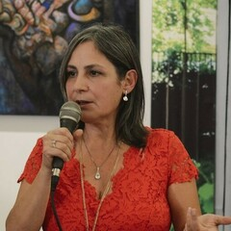
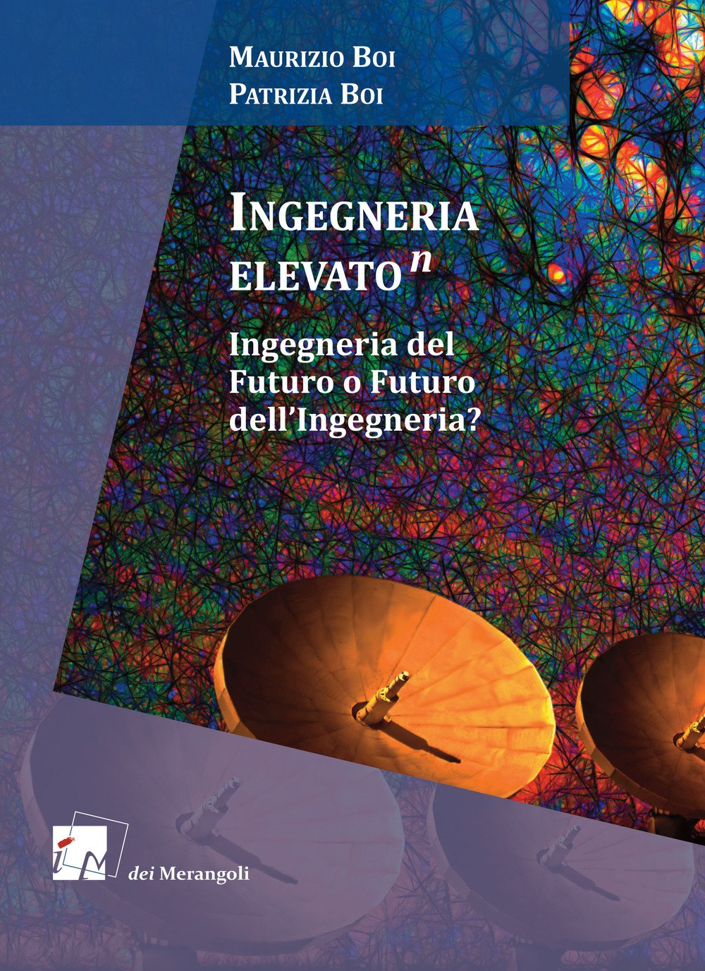
P A T R I Z I A B O I
"Call to Action"
Building the Future Together
Ready: «We are looking for the right location and an international team.».
The Invitation: «Let’s make the "Nuova Rinascita" a global model for human-centered engineering».
Contact: Patrizia Boi, Senior Engineer.

